Slide 1
Uncertainty Quantification
Few-shot Learning

Slide 2
Catalog
Few-Shot Learning
Uncertainty Quantification in Deep Learning
Application of UQ in Few-Shot Learning

Slide 3
Few-Shot Learning
(FSL)

Slide 4
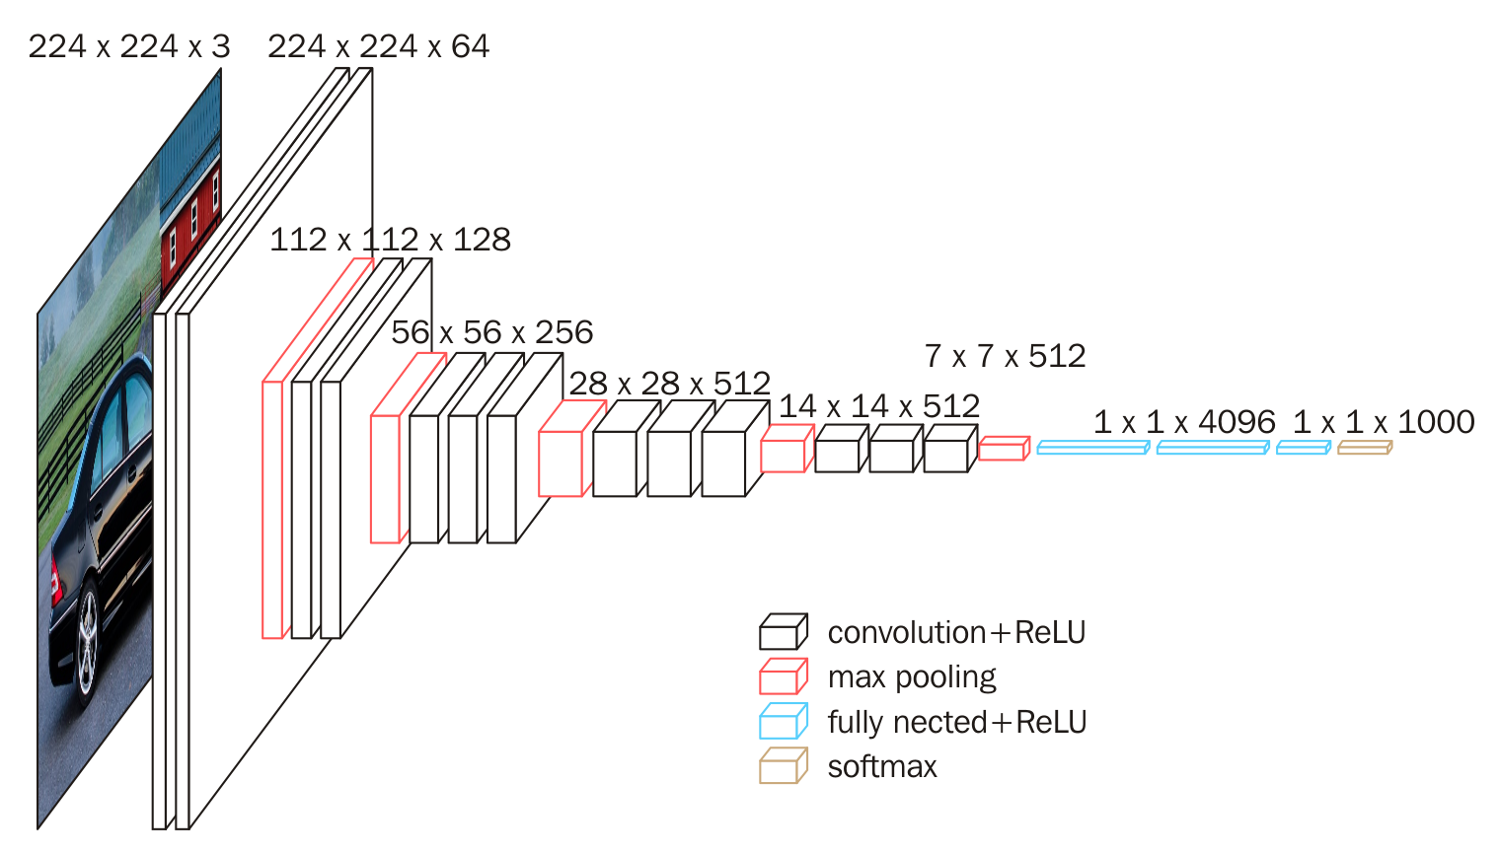
Traditional recognition framework
Traditional deep recognition models use large amounts of data to learn parameters.

Slide 5
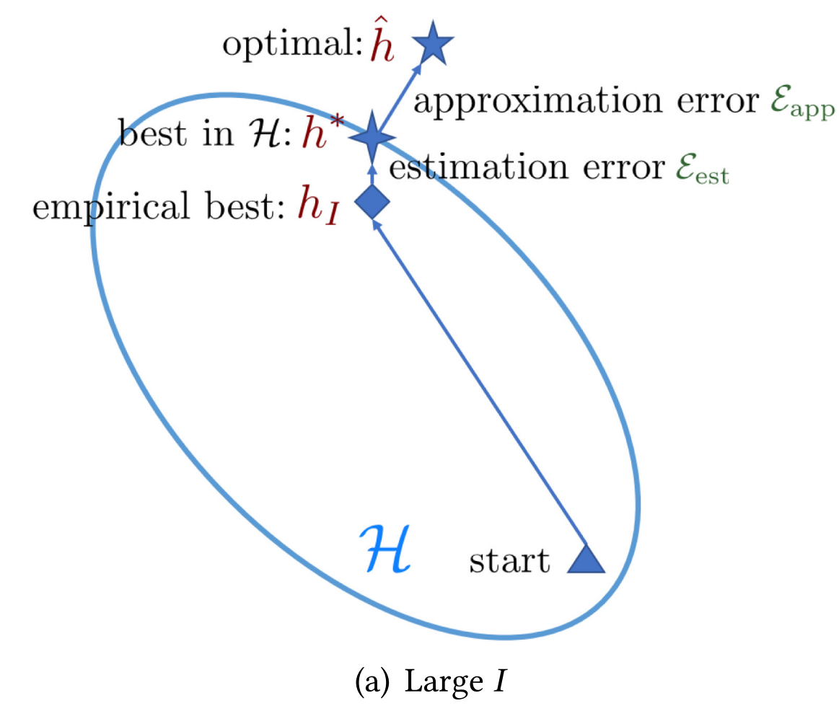
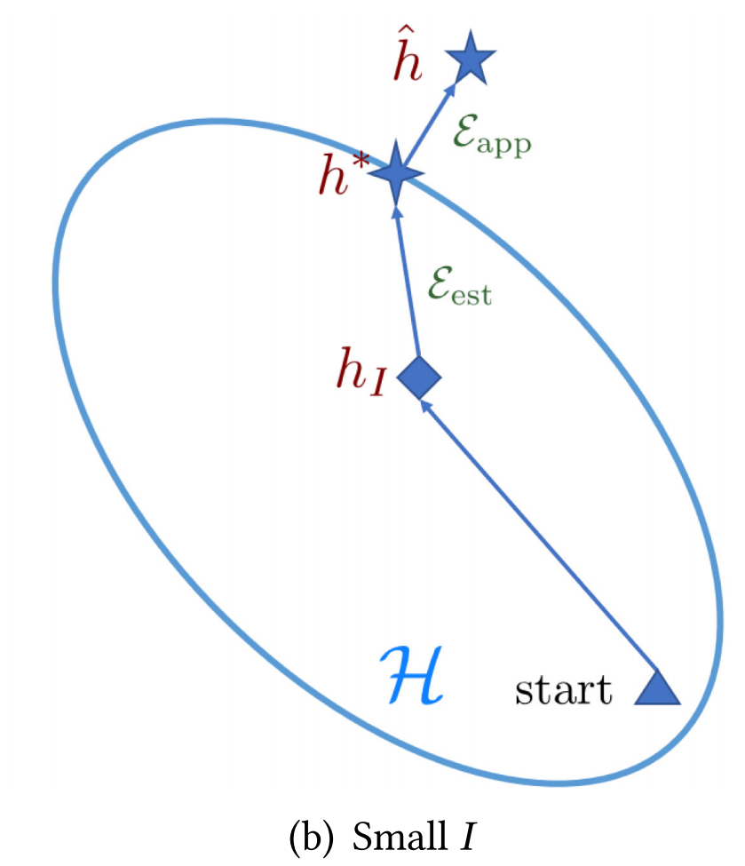
Overall
Trditional machine learning methods
Generalization ability of the model is guaranteed by a sufficient number of training samples.
Reference
[1] Lu J, Gong P, Ye J, et al. Learning from very few samples: A survey[J]. arXiv preprint arXiv:2009.02653, 2020.
[2] Wang Y, Yao Q, Kwok J T, et al. Generalizing from a few examples: A survey on few-shot learning[J]. ACM computing surveys (csur), 2020, 53(3): 1-34.

Slide 6
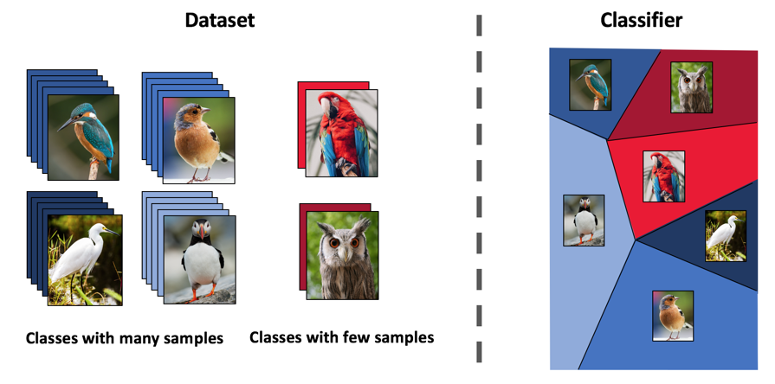
Overall
Few-Show Learning:
To learn from limited data with supervised information.
Classes with many samples
Classes with few samples

Slide 7
Overall
Few-Show Learning:
To learn from limited data with supervised information.
Success classification
Classes with many samples
Classes with few samples

Slide 8
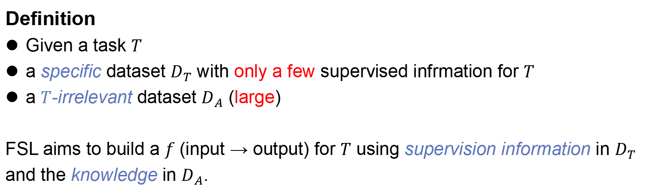
Overall
Definition
Given a task $T$
a specific dataset $D_{T}$ with only a few supervised infrmation for $T$
a $T$-irrelevant dataset $D_{A}$ (large)
FSL aims to build a $f$ (input → output) for $T$ using supervision information in $D_{T}$ and the knowledge in $D_{A}$.
Reference
[1] Lu J, Gong P, Ye J, et al. Learning from very few samples: A survey[J]. arXiv preprint arXiv:2009.02653, 2020.

Slide 9
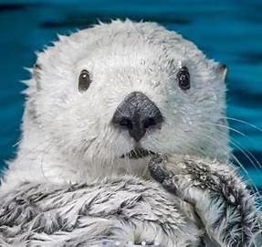
Metric learning
What’s animal?

Slide 10
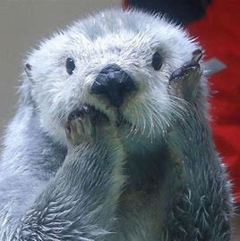
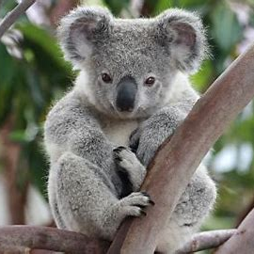
Metric learning
Enhydra lutris
Kola

Slide 11
Metric learning
Enhydra lutris
Kola

Slide 12
Metric learning
Enhydra lutris
Enhydra lutris
Kola

Slide 13
Metric learning
Query set
Support set
Enhydra lutris
Enhydra lutris
Kola

Slide 14
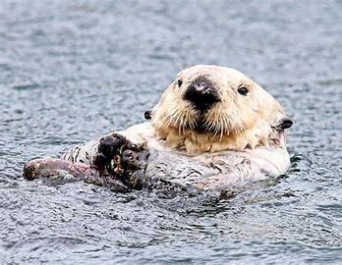
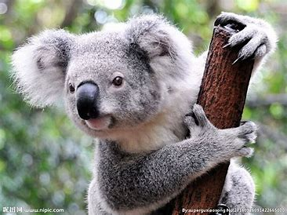
Metric learning
Support set

Slide 15
Metric learning
Support set
Feature Vector
CNN
CNN
CNN
CNN

Slide 16
Metric learning
Support set
Feature Vector
CNN
Enhydra lutris
CNN
CNN
Kola
CNN

Slide 17
Metric learning
Feature extraction of Query set
CNN

Slide 18
Metric learning
Feature extraction of Query set
CNN
Enhydra lutris
Support set
Kola
Query set
Unknow

Slide 19
Metric learning
Enhydra lutris
Kola
Unknow

Slide 20
Metric learning
Metric (Cosine similarity )
Enhydra lutris
Enhydra lutris
Kola
Kola
Unknow

Slide 21
Metric learning
Metric (Cosine similarity )
Enhydra lutris
Enhydra lutris
Kola
Kola
Enhydra lutris

Slide 22
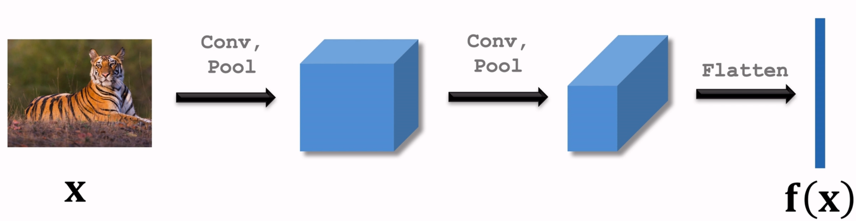
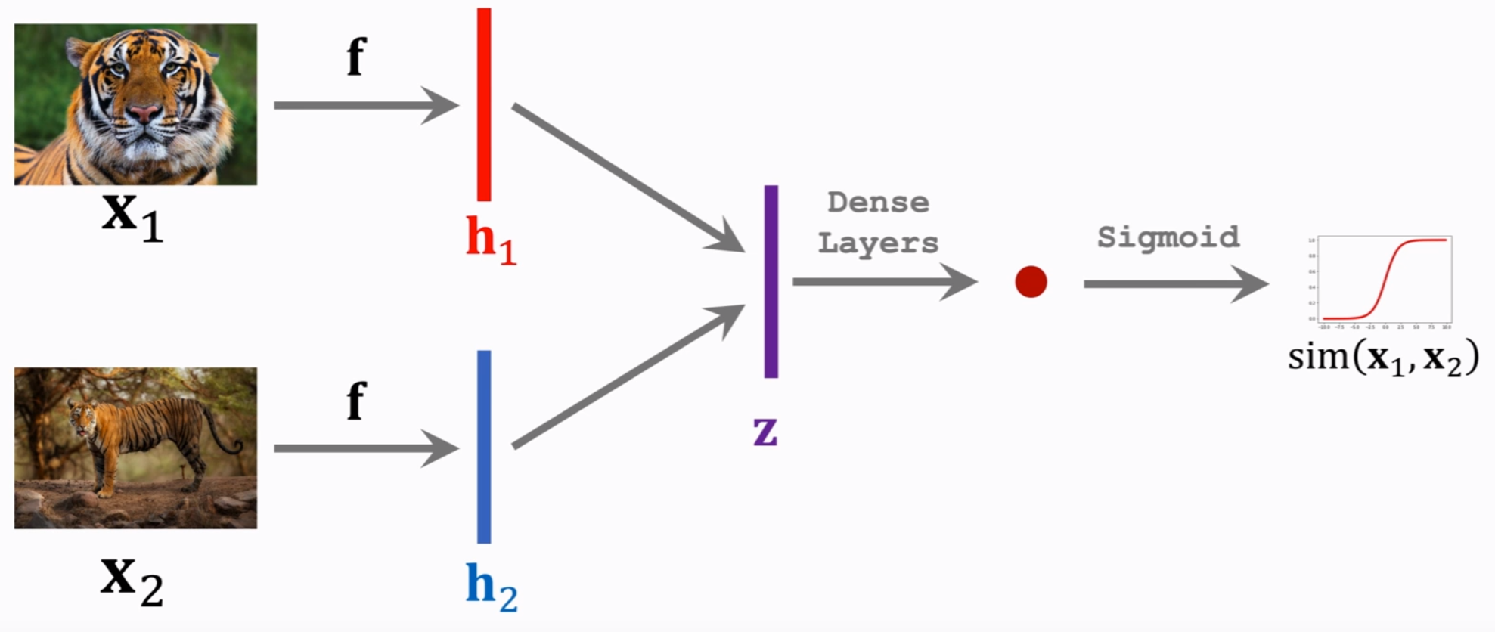
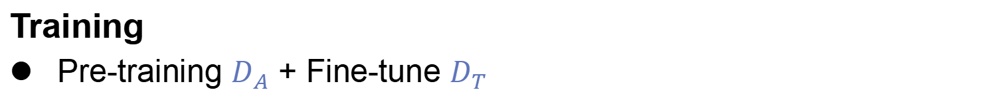
Metric learning
Training
Pre-training $D_{A}$ + Fine-tune $D_{T}$

Slide 23
Uncertainty Quantification

Slide 24
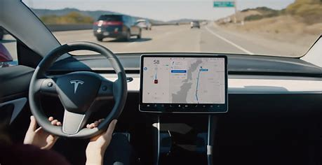
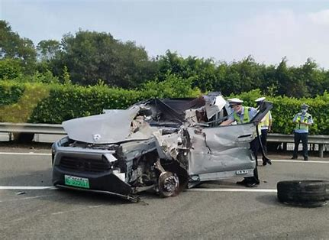
Hazards of AI
"99%" is unacceptable in the field of autonomous driving.
Overconfident incorrect predictions can be harmful or offensive
Reference
[3] NHTSA. PE 16-007. Technical report, U.S. Department of Transportation, National Highway Traffic Safety Administration, Jan 2017. Tesla Crash Preliminary Evaluation Report.

Slide 25
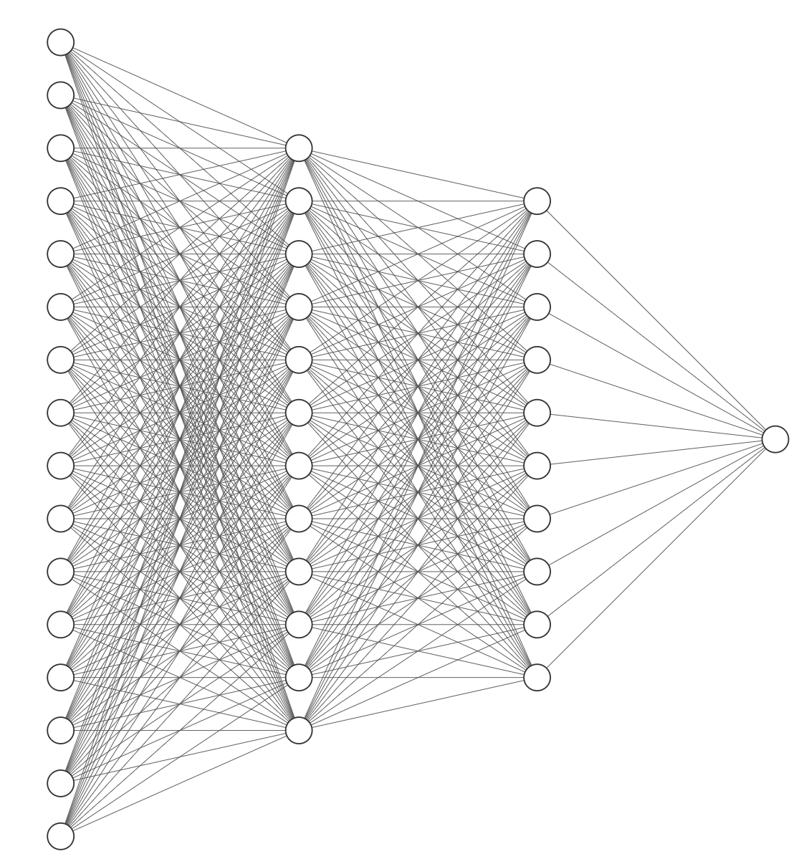
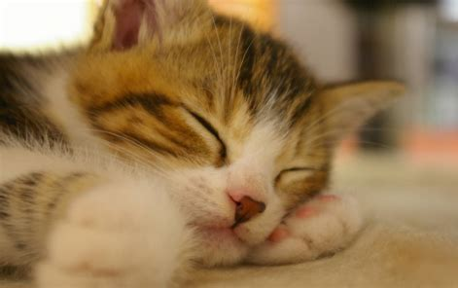
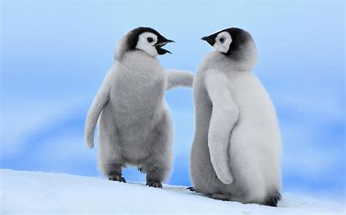
Hazards of AI
Overconfident
Predictions of neural networks are not always accurate.
Neural networks don't tell us "I don't know".
Cat & Dog
Cat ✔
Cat ？

Slide 26
Uncertainty
The AI system gives the uncertainty level along with the predictions result. Guiding humans to make more rational decisions
Prediction
Uncertainty

Slide 27
Uncertainty
The AI system gives the uncertainty level along with the predictions result. Guiding humans to make more rational decisions
Prediction
Uncertainty
Uncertainty Quantification

Slide 28
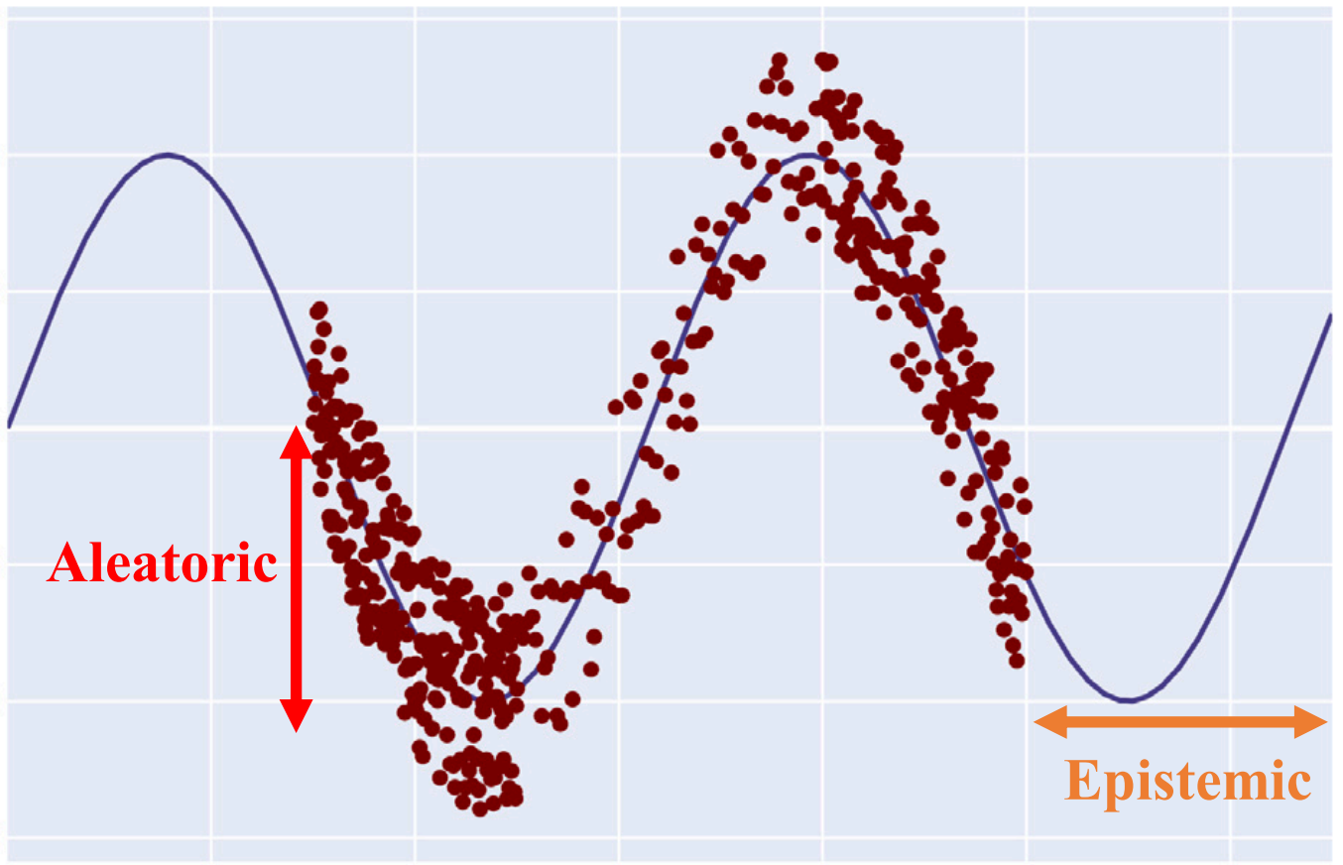
Uncertainty
Aleatoric uncertainty: Inherent noise of training data
Epistemic uncertainty: Model generalization capability
The difference of aleatoric uncertainty and epistemic uncertainty
Reference
[4] Abdar M, Pourpanah F, Hussain S, et al. A review of uncertainty quantification in deep learning: Techniques, applications and challenges[J]. Information Fusion, 2021, 76: 243-297.

Slide 29
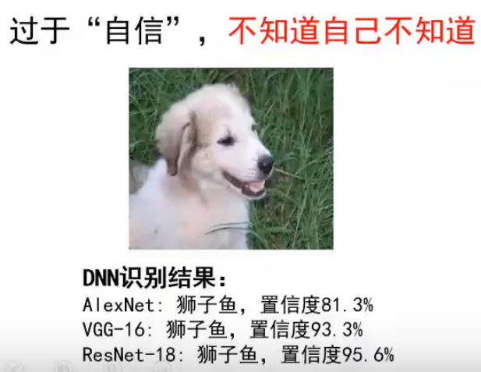
Uncertainty
Aleatoric uncertainty
from Data
Epistemic uncertainty
from Model
Reference
[5] 朱军——贝叶斯深度学习（线上讲座）清华大学 2022.9.
[6] 深度学习中的两种不确定性 https://zhuanlan.zhihu.com/p/56986840

Slide 30
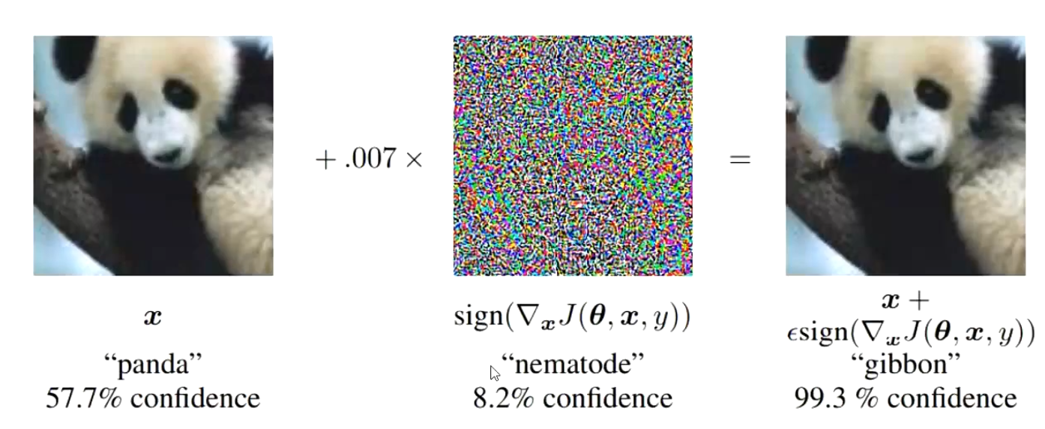
Uncertainty
Adversarial attack
Slight noise disturbance affects the results

Slide 31
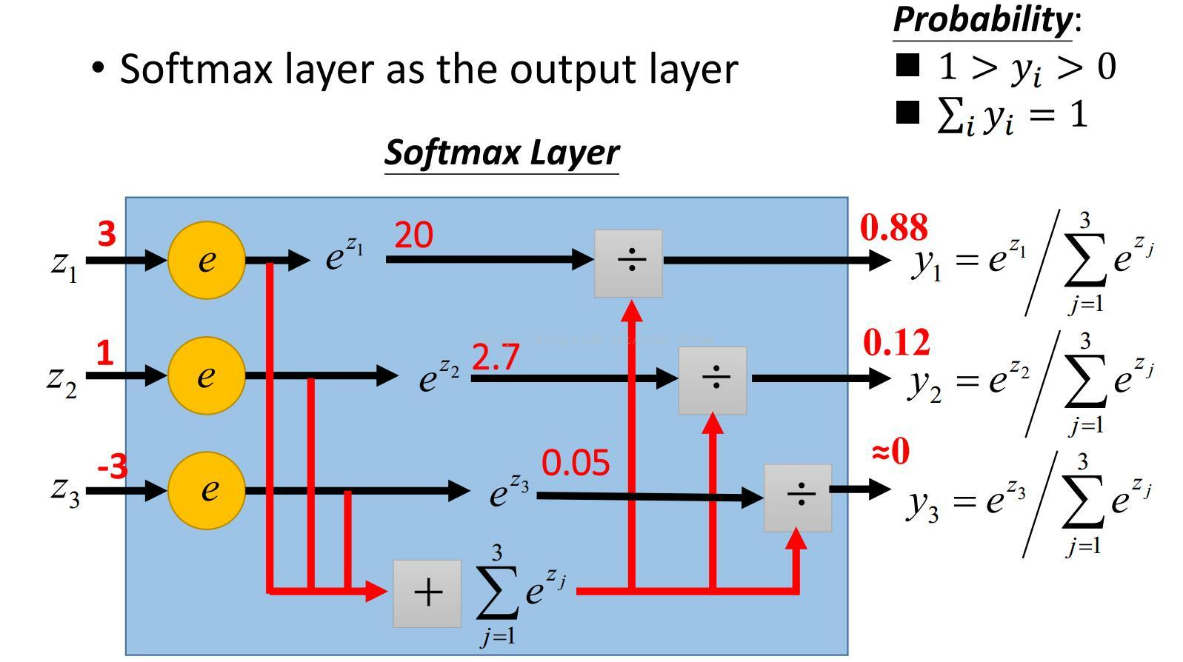
Confidence vs Uncertainty
Confidence?
Uncertainty?

Slide 32
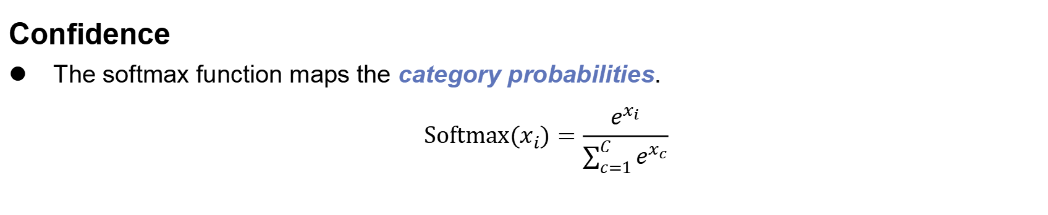
Confidence vs Uncertainty
Confidence
The softmax function maps the category probabilities.
$$Softmax(x_{i})=\frac{e^{x_{i}}}{\sum_{c=1}^{C}{e^{x_{c}}}}$$
Reference
[7] 贝叶斯神经网络及其在自动驾驶中的应用
[8] What My Deep Model Doesn't Know... http://www.cs.ox.ac.uk/people/yarin.gal/website/blog_3d801aa532c1ce.html

Slide 33
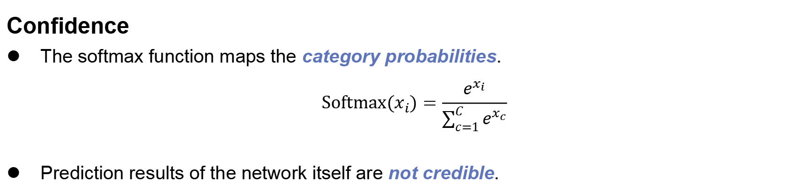
Confidence vs Uncertainty
Confidence
The softmax function maps the category probabilities.
$$Softmax(x_{i})=\frac{e^{x_{i}}}{\sum_{c=1}^{C}{e^{x_{c}}}}$$
Prediction results of the network itself are not credible.
Confidence ≠ Uncertainty
Reference
[7] 贝叶斯神经网络及其在自动驾驶中的应用
[8] What My Deep Model Doesn't Know... http://www.cs.ox.ac.uk/people/yarin.gal/website/blog_3d801aa532c1ce.html

Slide 34
Confidence vs Uncertainty
Uncertainty
Measuring the Credibility of Confidence.
Reflects the degree of dispersion of random variable.
The dispersion of random variables consisting of multiple Confidences of the same class under multiple model settings.
Reference
[7] 贝叶斯神经网络及其在自动驾驶中的应用

Slide 35
Uncertainty Quantification Methods

Slide 36
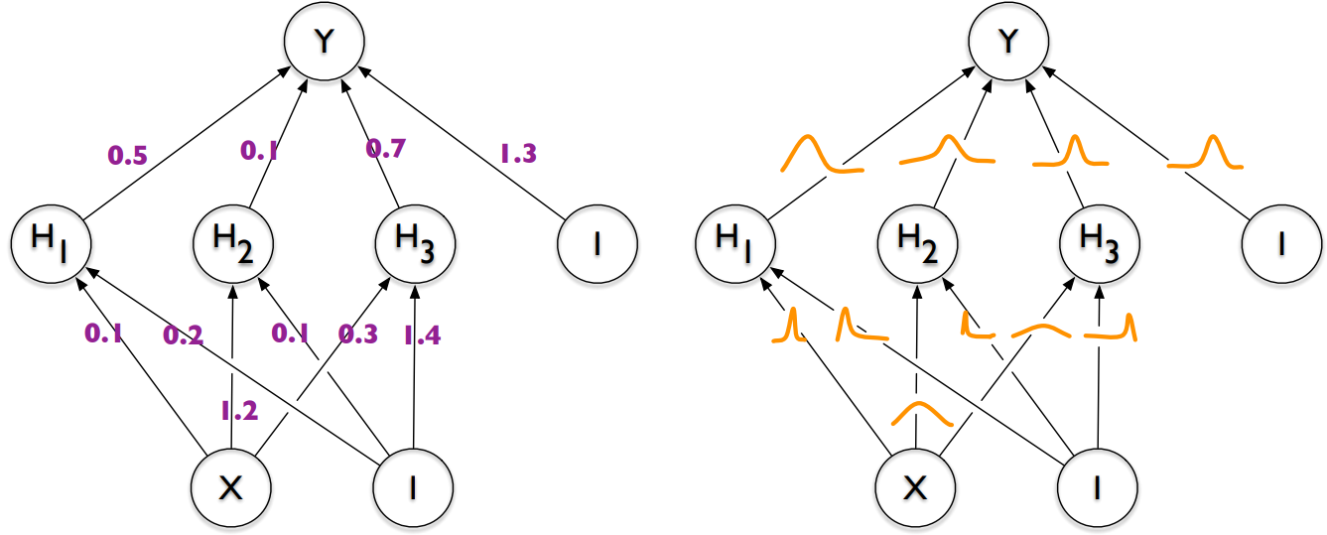
Bayeian neural network
BNN
The parameter is a distribution, not a fixed value.
Normal NN
BNN
Reference
[9] Blundell C, Cornebise J, Kavukcuoglu K, et al. Weight uncertainty in neural network[C] ICLR, 2015: 1613-1622.

Slide 37
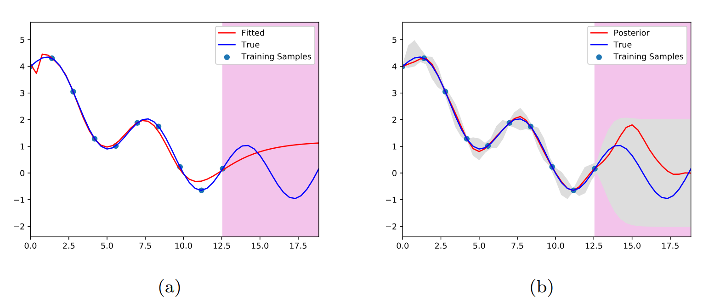
Bayeian neural network
Comparison of neural network to BNN for a regression task
Reference
[10] Goan E, Fookes C. Bayesian neural networks: An introduction and survey[J]. Case Studies in Applied Bayesian Data Science: CIRM Jean-Morlet Chair, Fall 2018, 2020: 45-87.

Slide 38
Uncertainty Quantification
Variational Inference

Slide 39
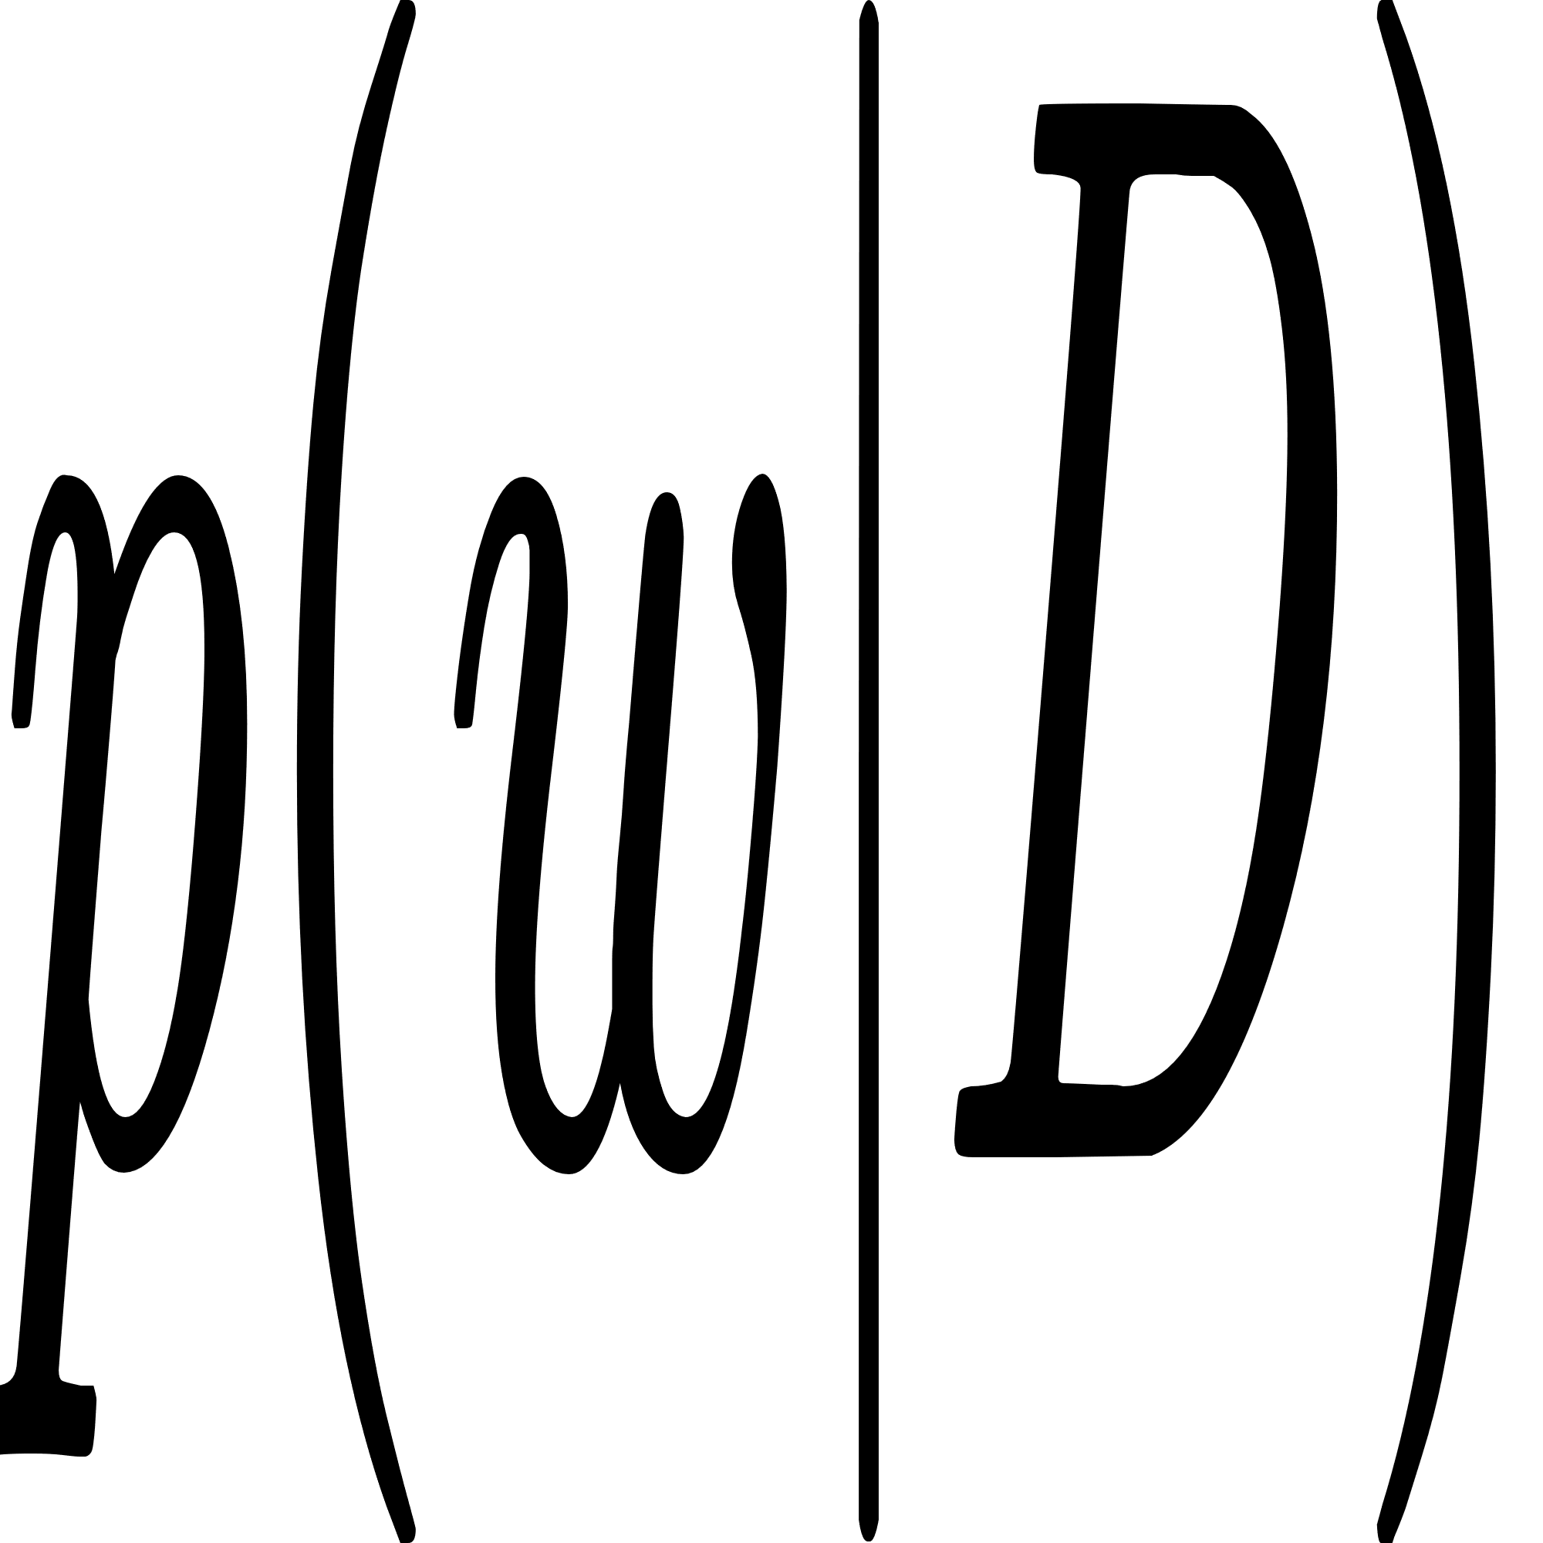
Variational Inference
Inferring the posteriori probabilities with prior probabilities
NN
Data

Slide 40
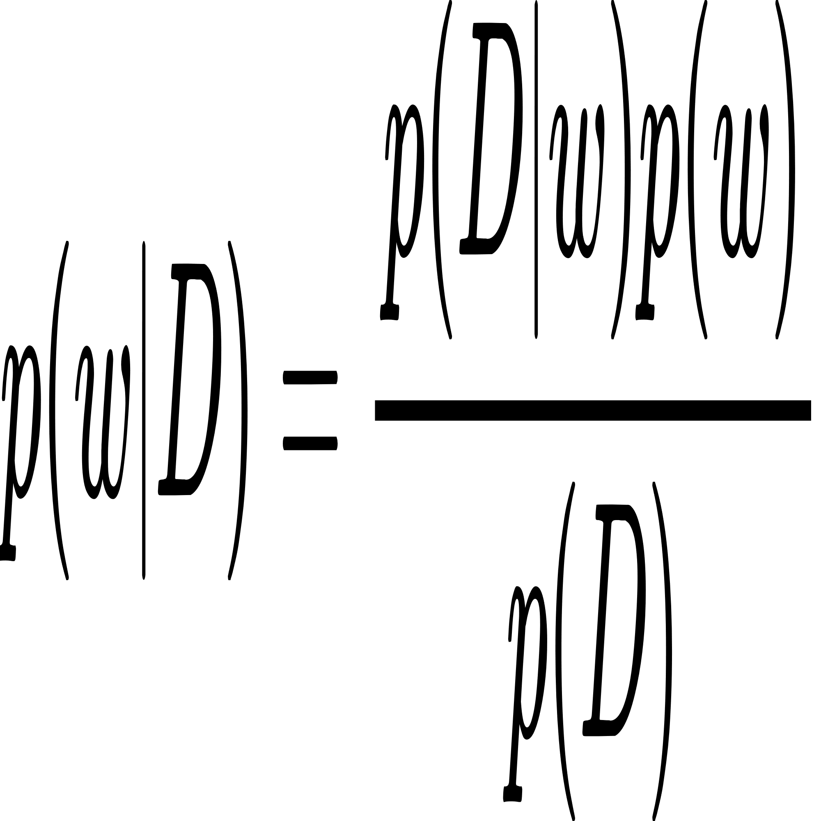
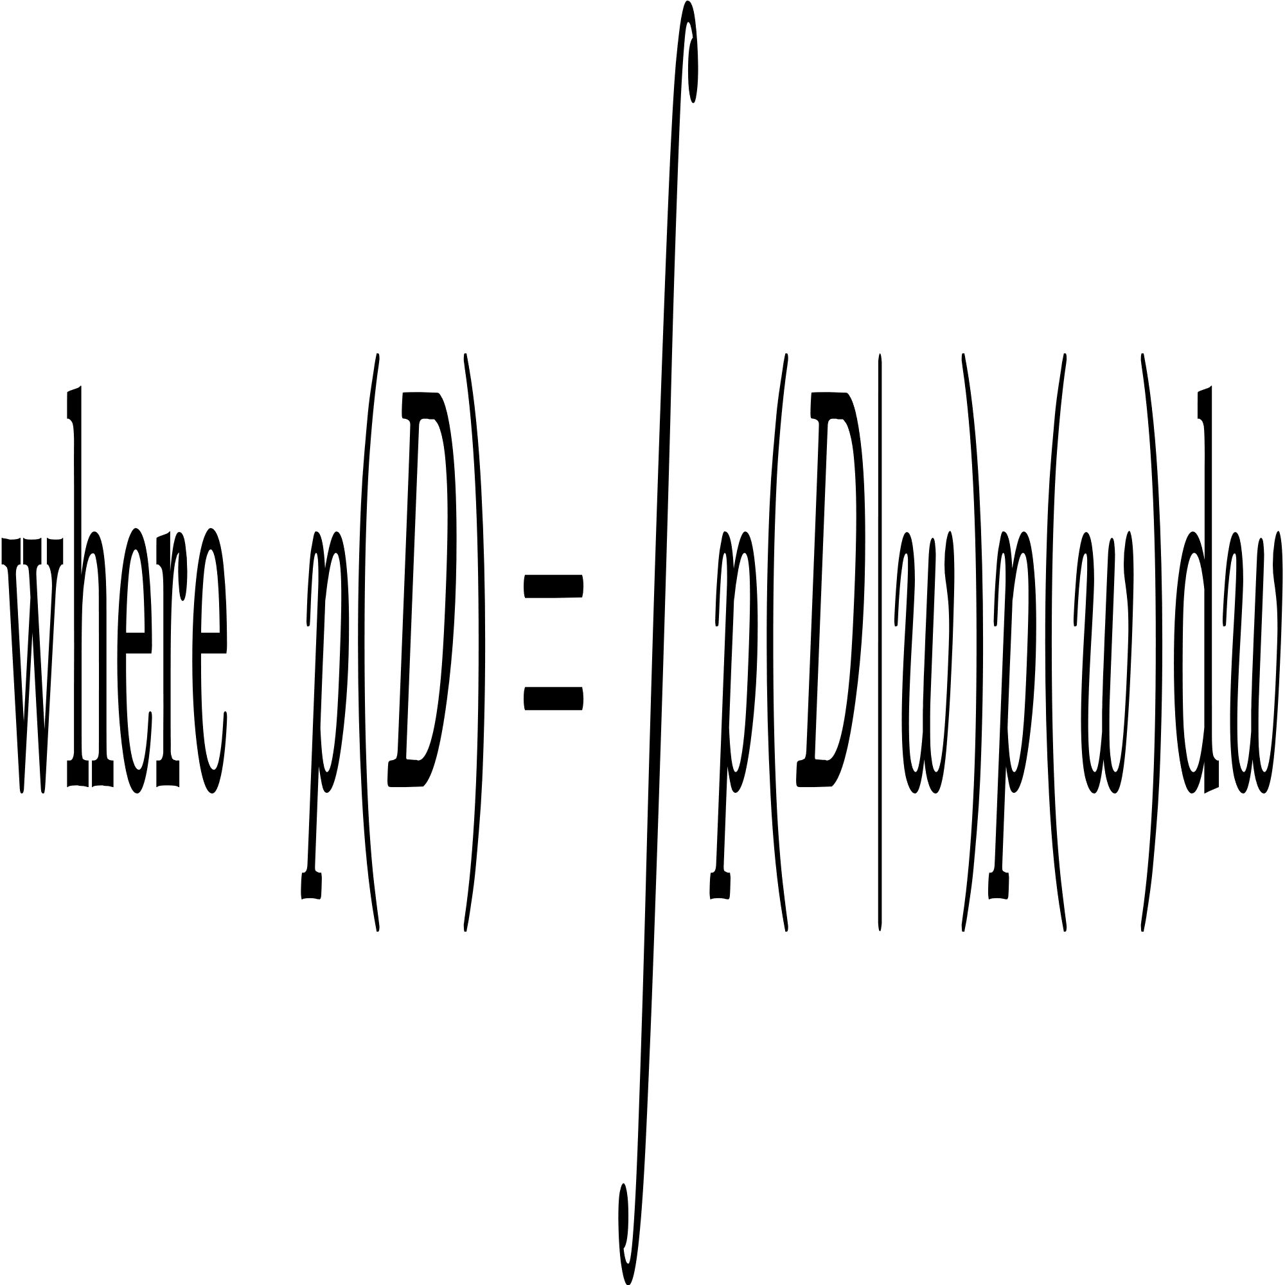
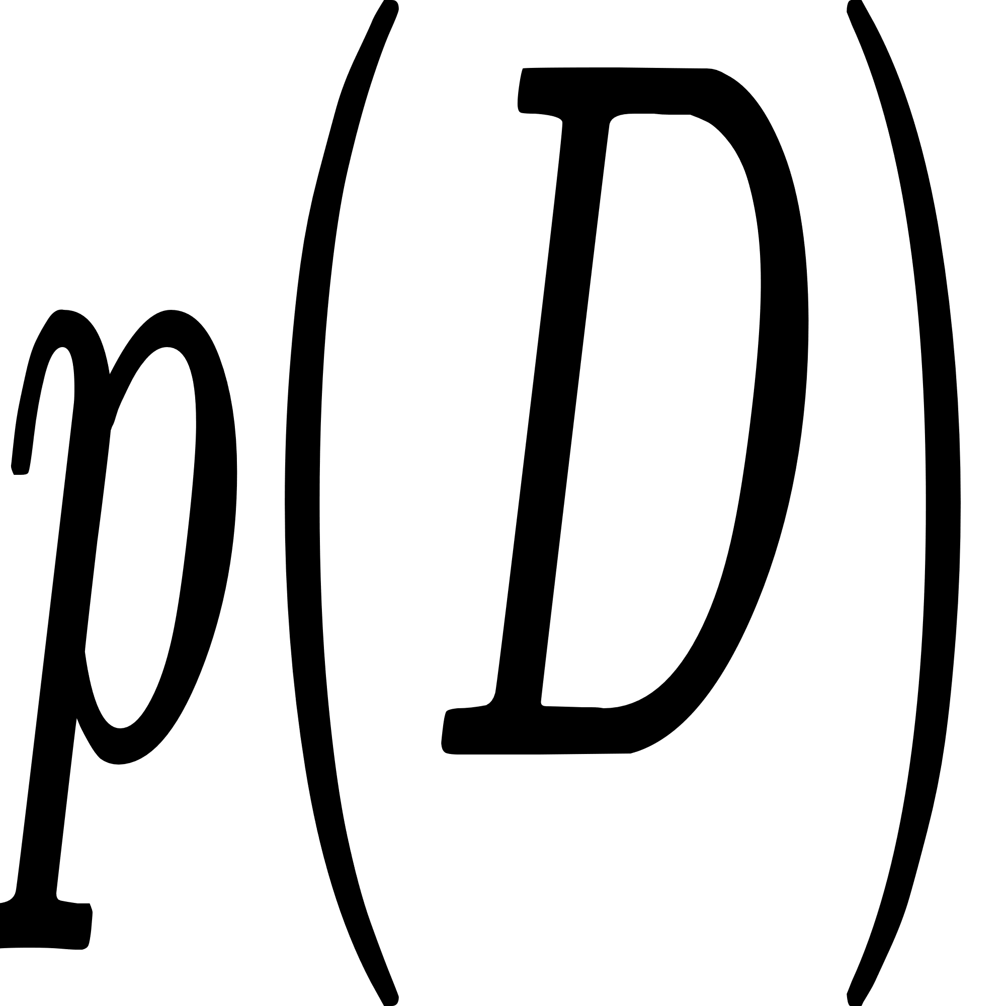
Variational Inference
Inferring the posteriori probabilities with prior probabilities
NN
Data
hard to caculate.

Slide 41
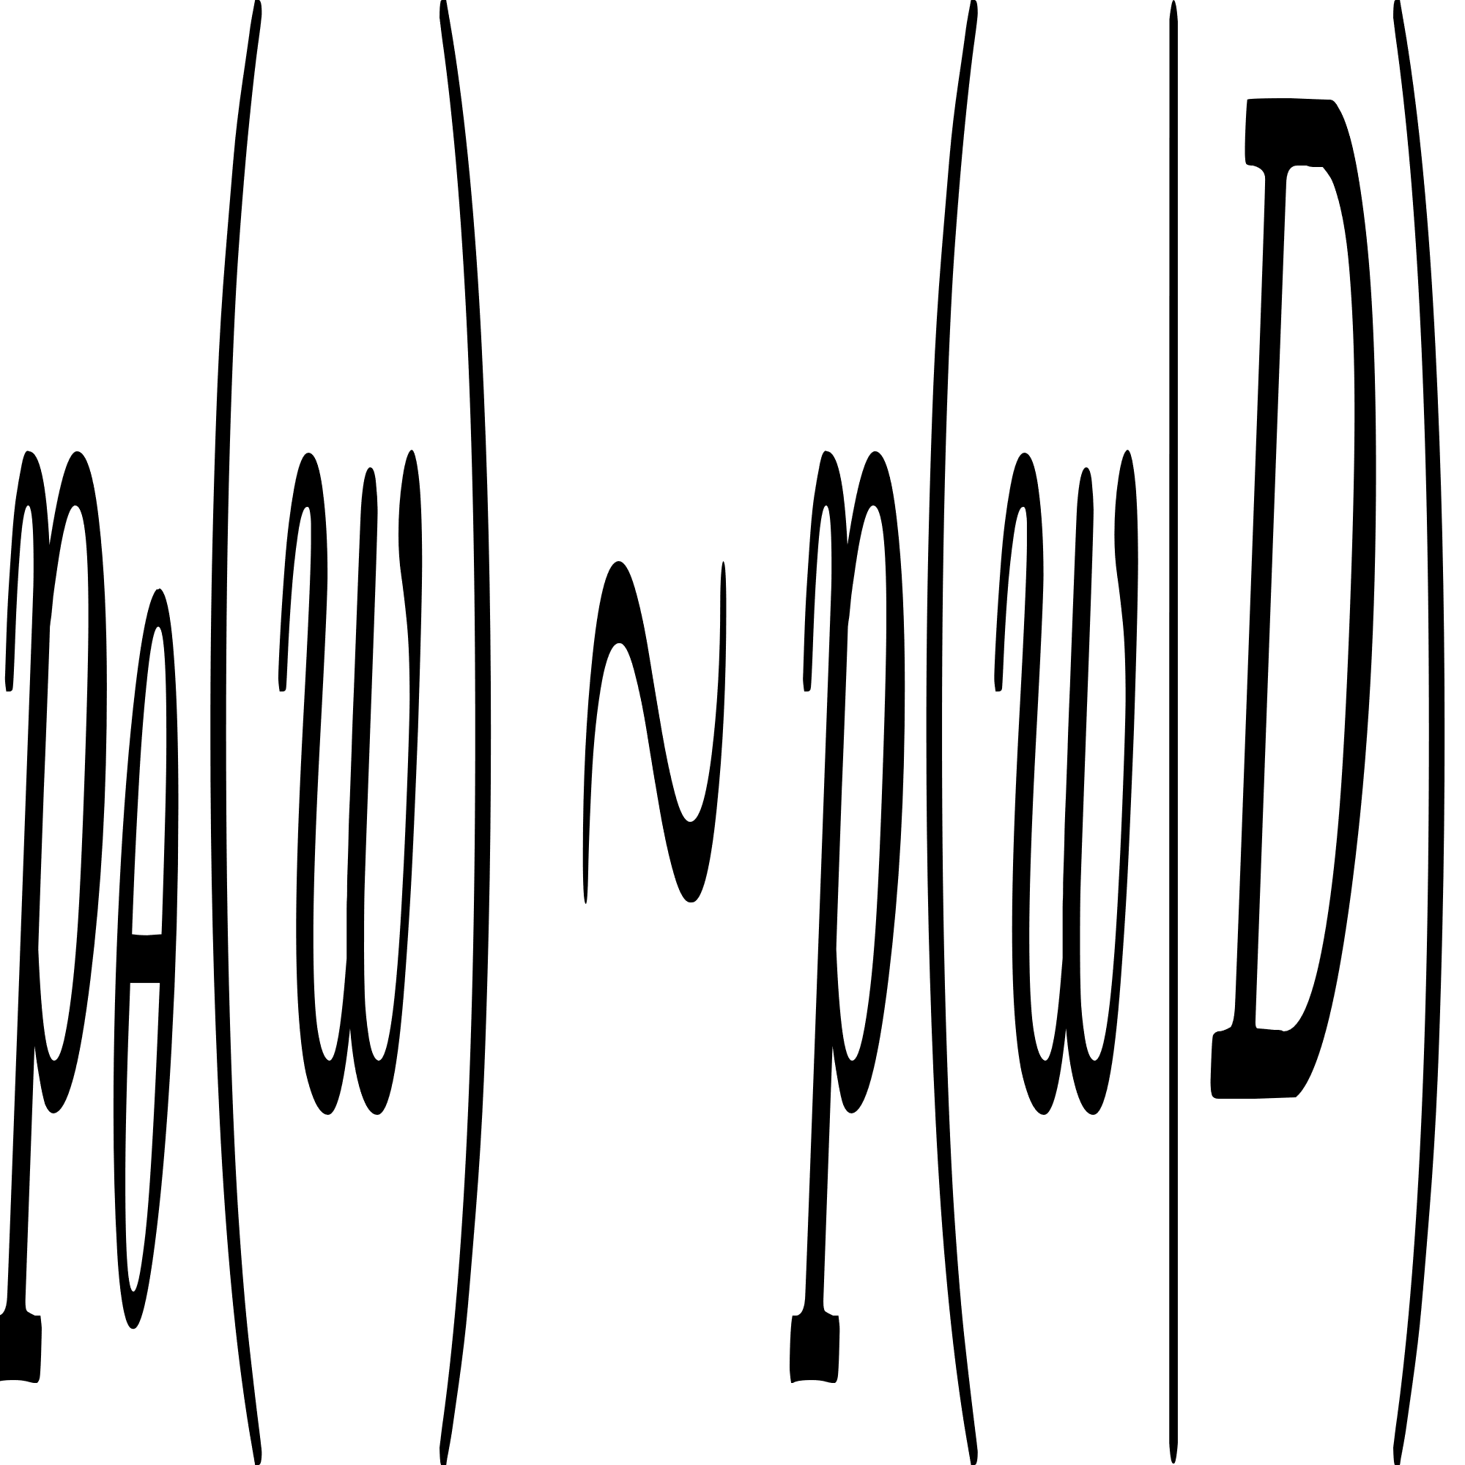
Variational Inference
VI-based methods Using the new distribution to approximate
consider the Bayesian inference problem as an optimization problem.
Reference
[4] Abdar M, Pourpanah F, Hussain S, et al. A review of uncertainty quantification in deep learning: Techniques, applications and challenges[J]. Information Fusion, 2021, 76: 243-297.

Slide 42
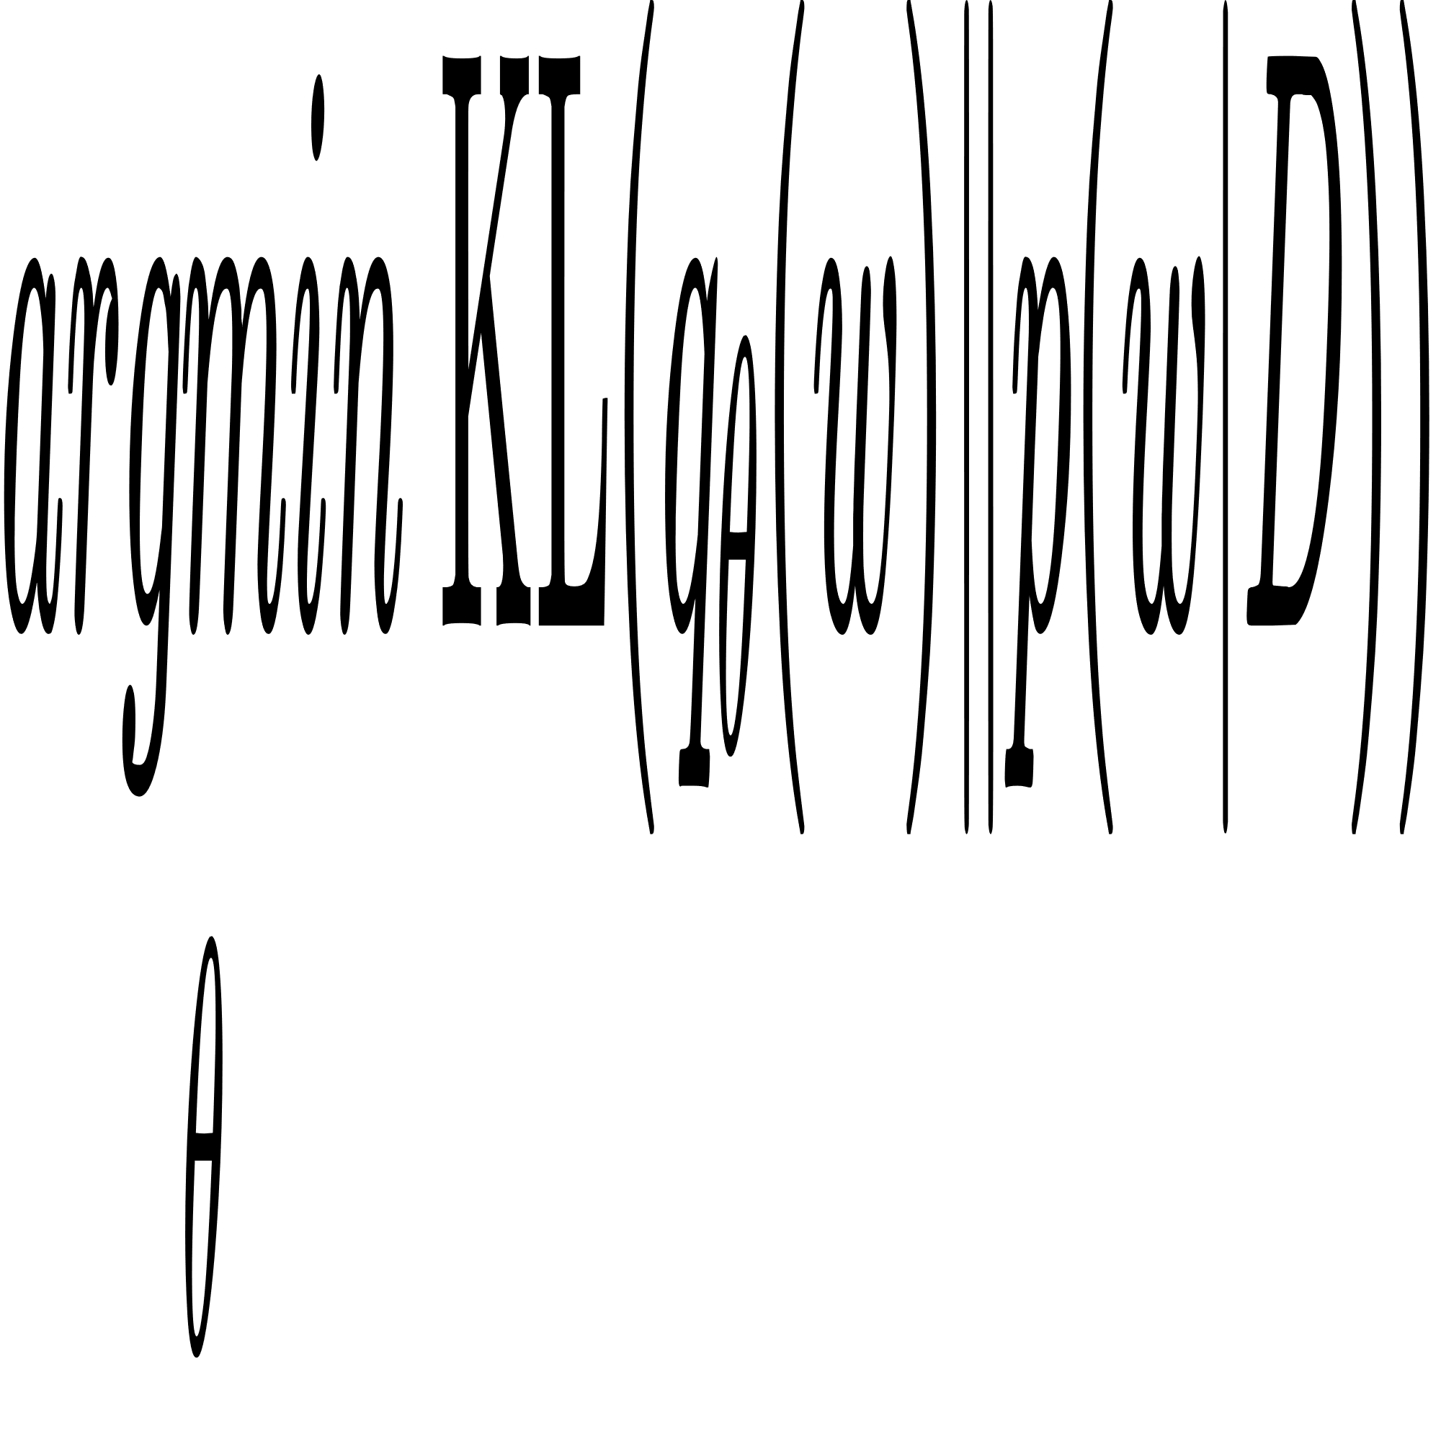
Variational Inference
VI-based methods Using the new distribution to approximate
consider the Bayesian inference problem as an optimization problem.
Minimize KL-dispersion
Reference
[4] Abdar M, Pourpanah F, Hussain S, et al. A review of uncertainty quantification in deep learning: Techniques, applications and challenges[J]. Information Fusion, 2021, 76: 243-297.

Slide 43
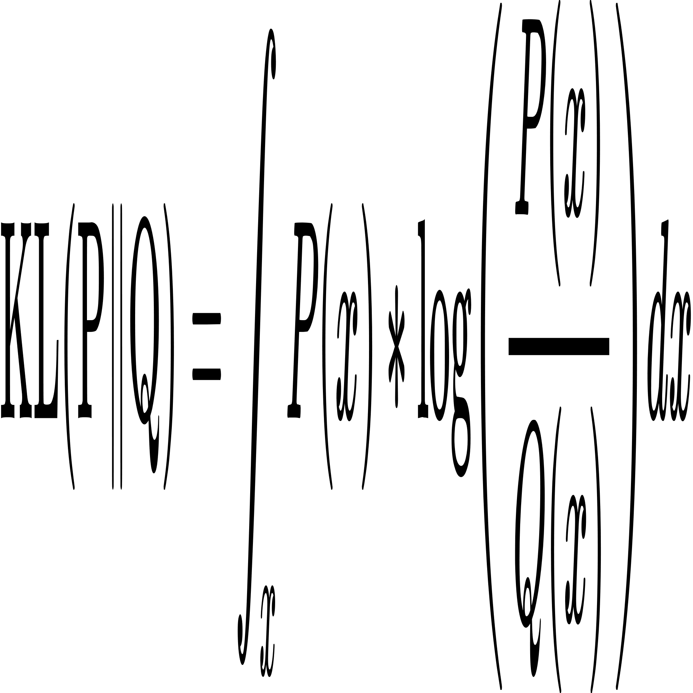
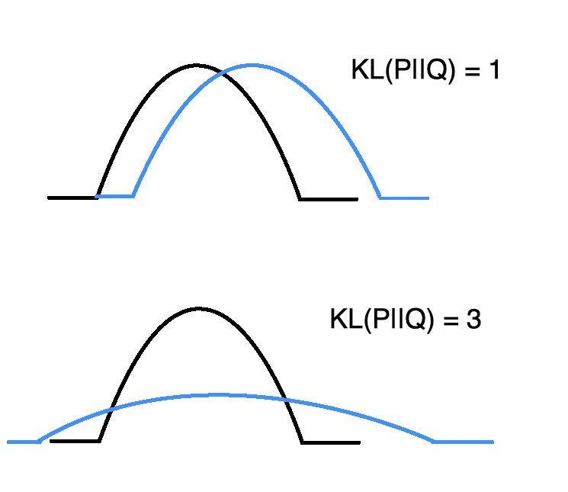
Variational Inference
KL-dispersion
Describe the difference between two probability distributions
Reference
[21] KL散度超详细讲解. https://blog.csdn.net/weixin_37763870/article/details/103026505

Slide 44
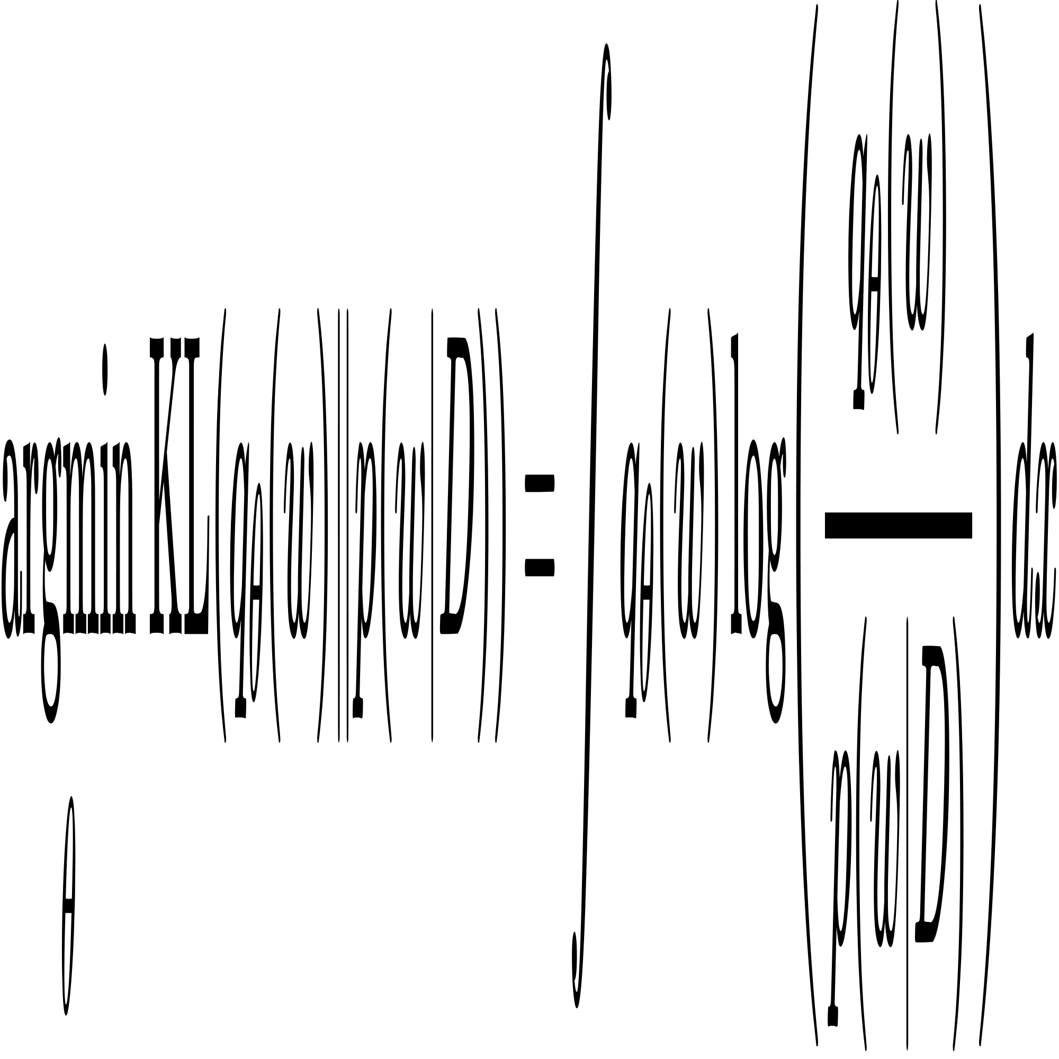
Variational Inference
Reference
[22] 「变分推断-1」贝叶斯统计 详细推导 Variational Inference「机器学习」

Slide 45
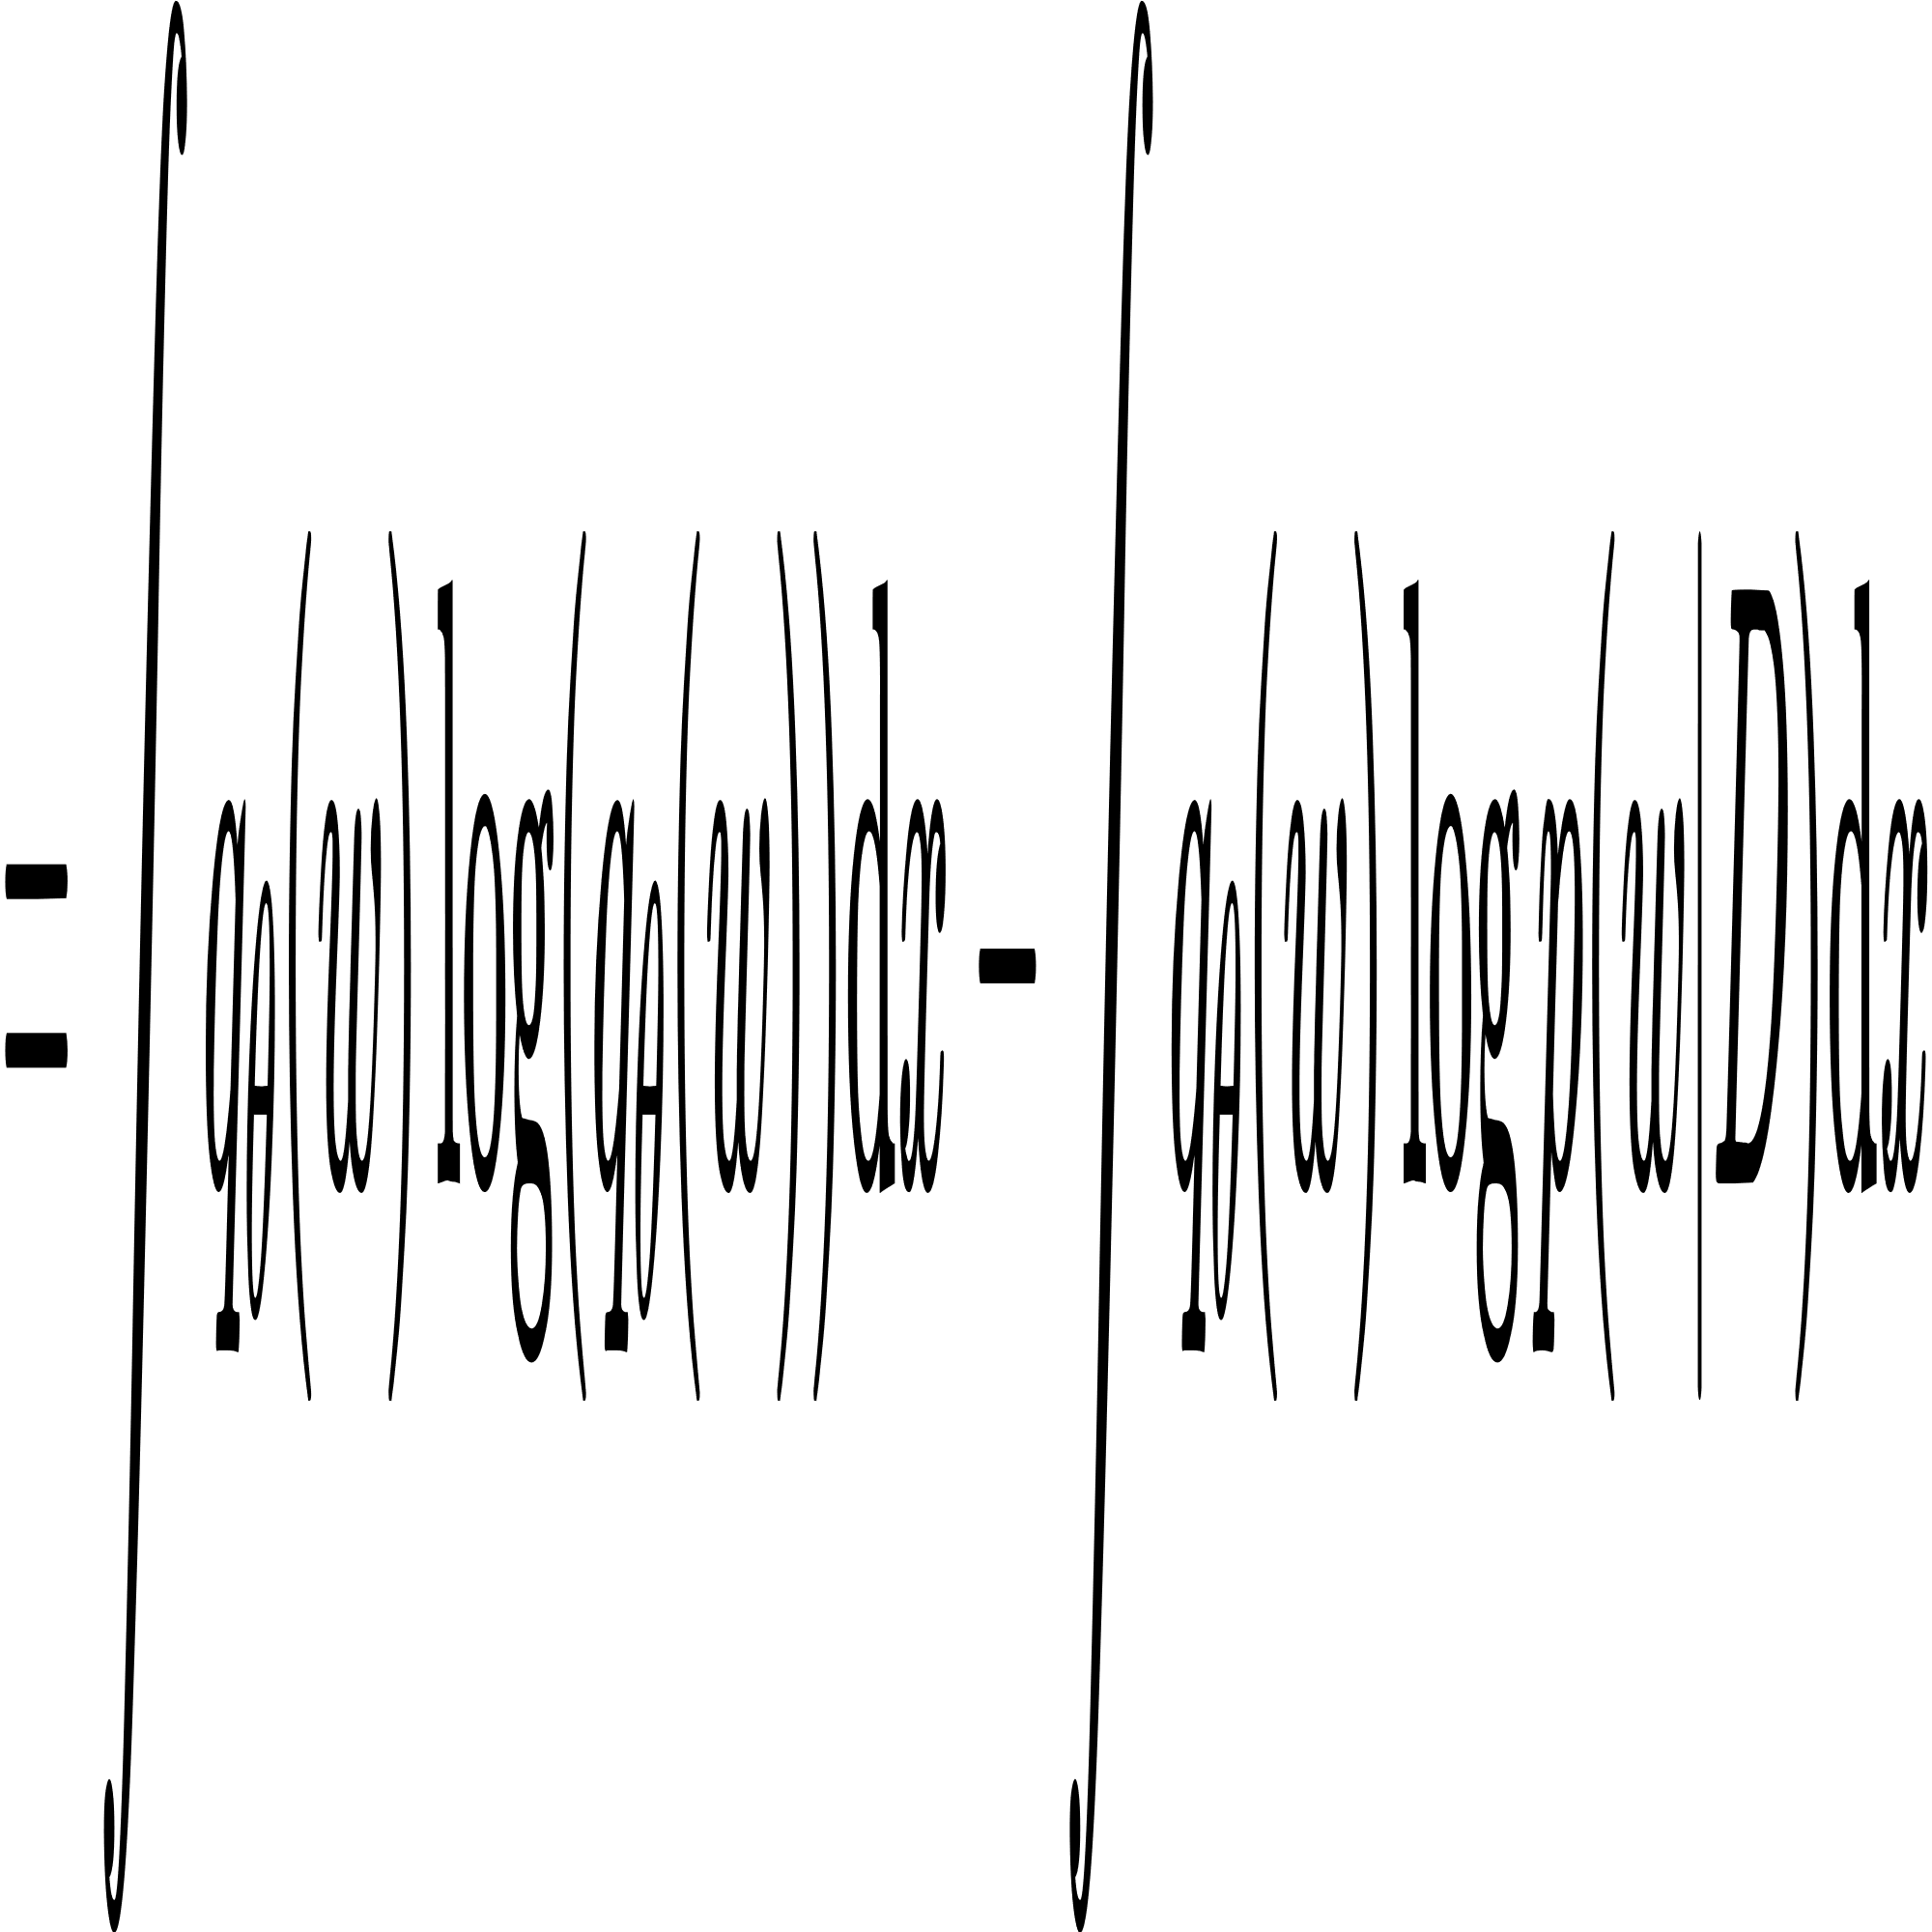
Variational Inference
Reference
[22] 「变分推断-1」贝叶斯统计 详细推导 Variational Inference「机器学习」

Slide 46
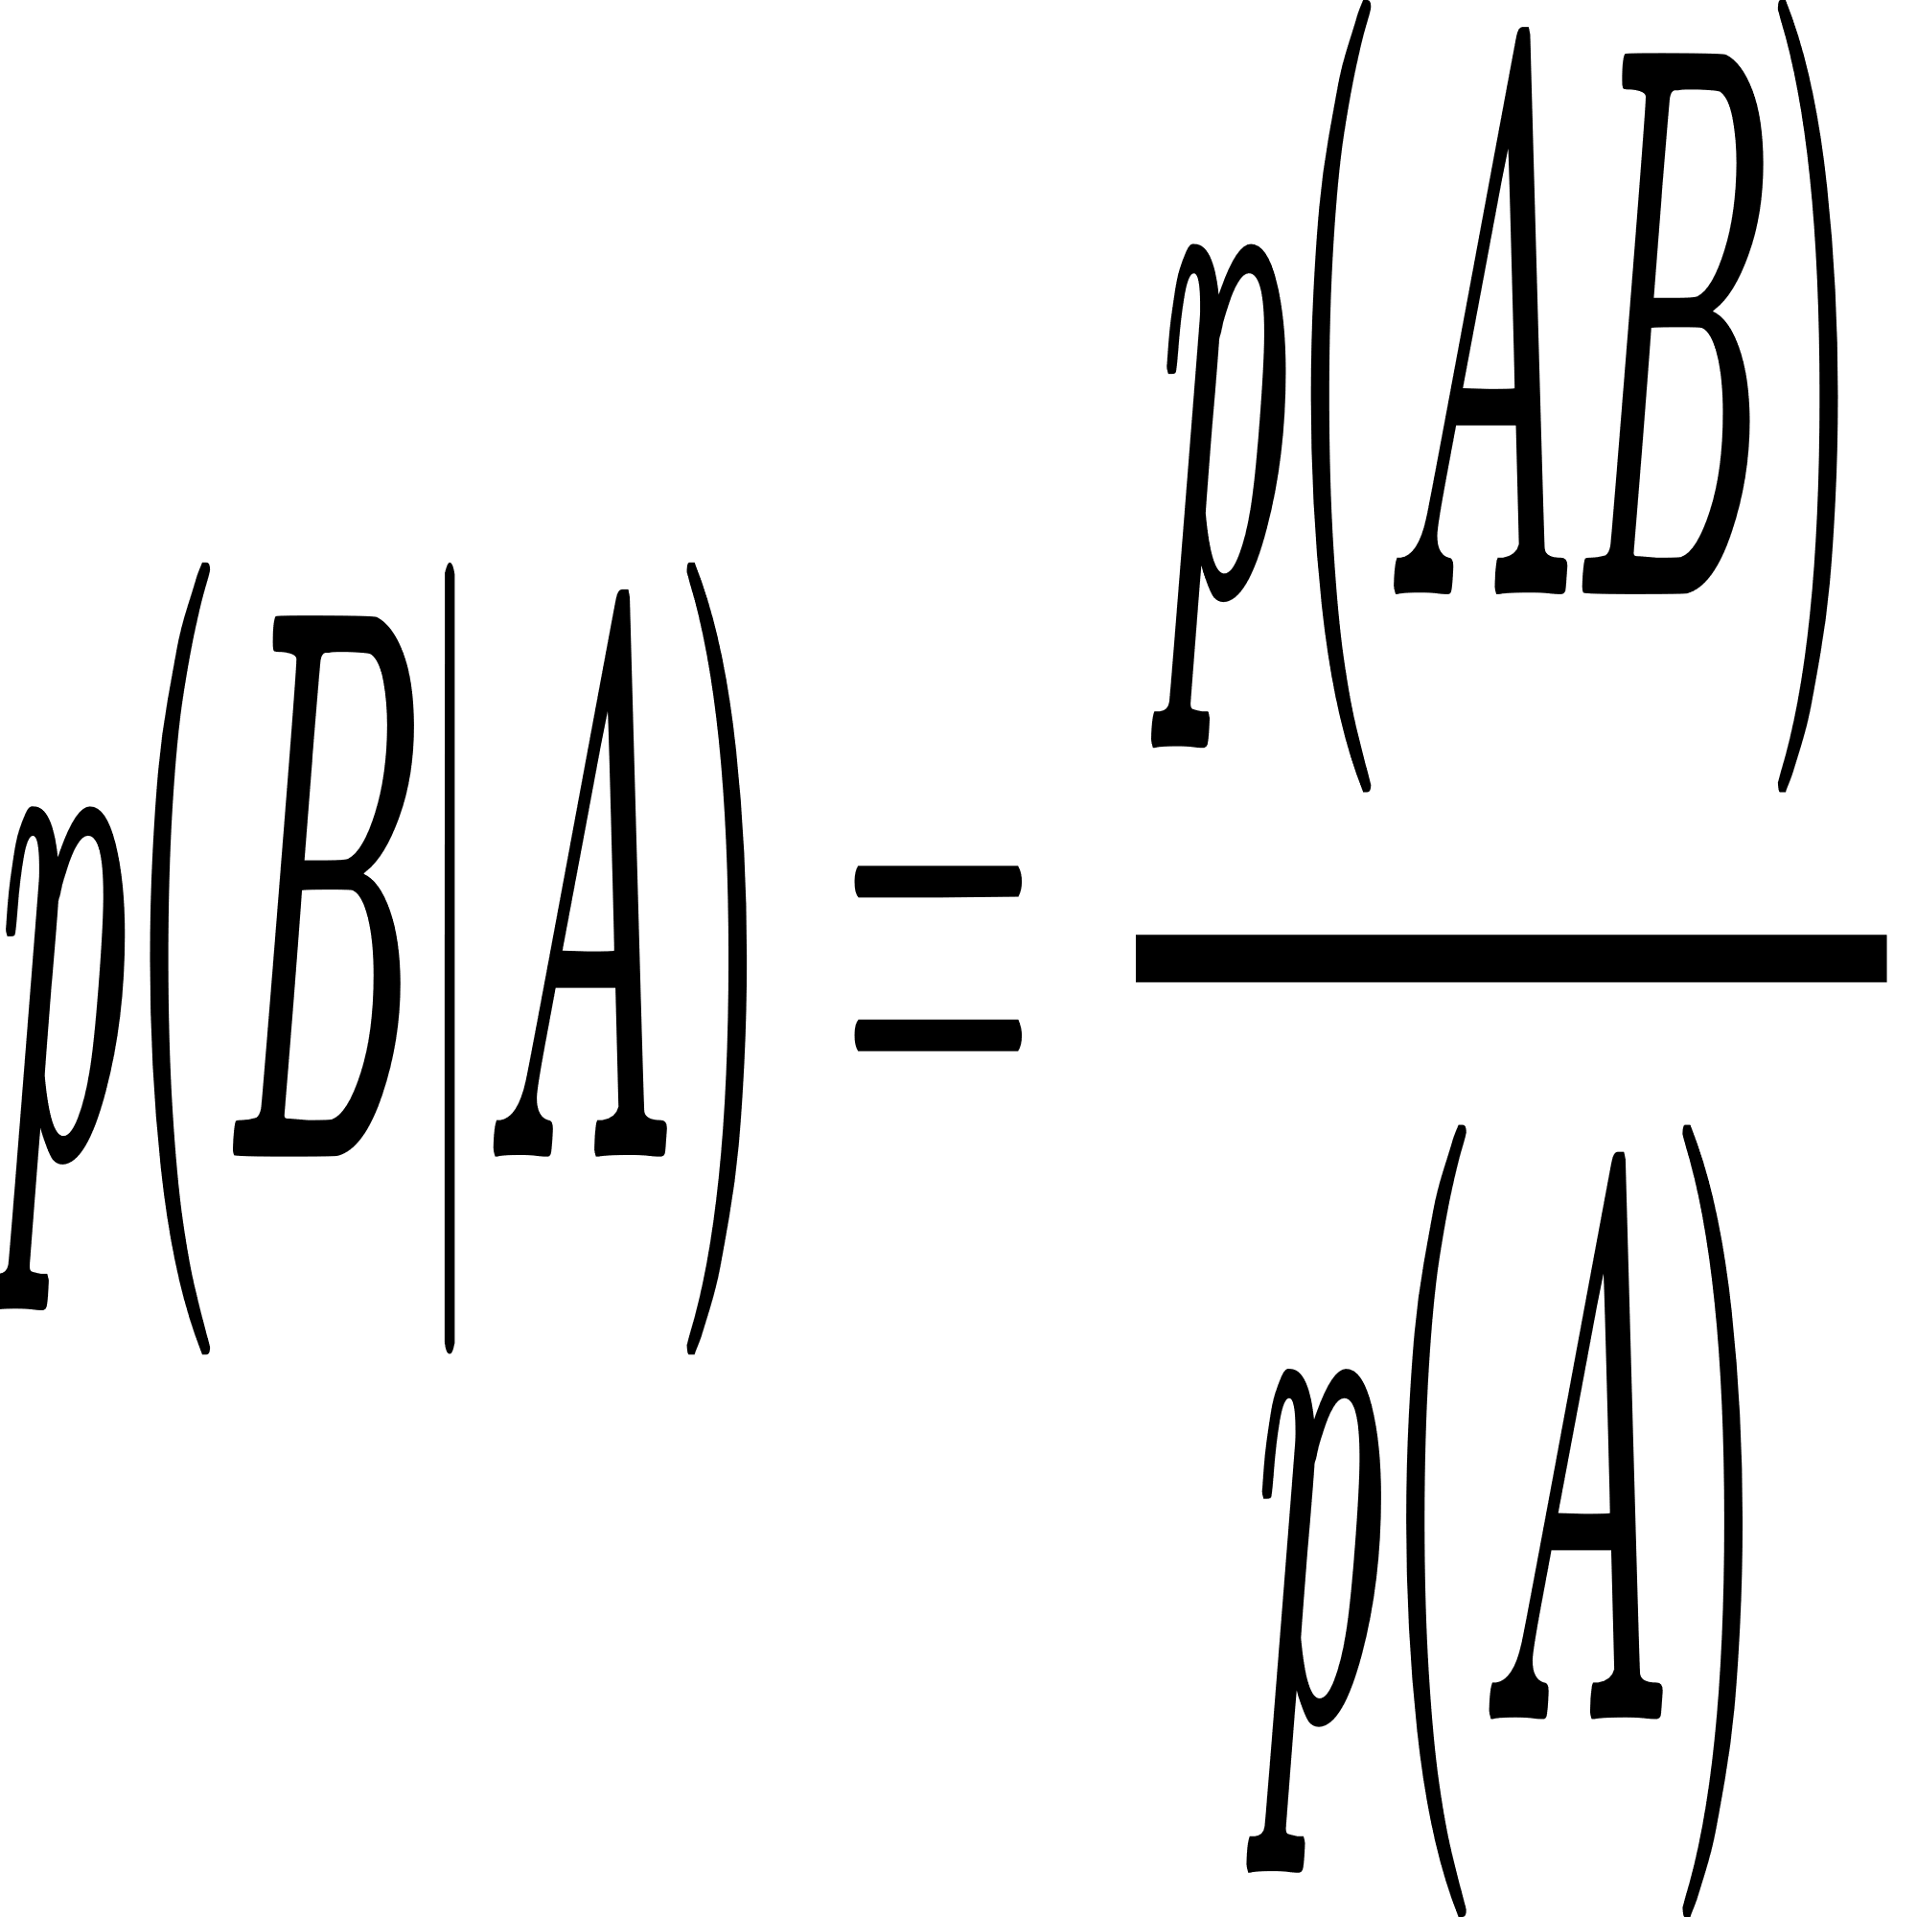
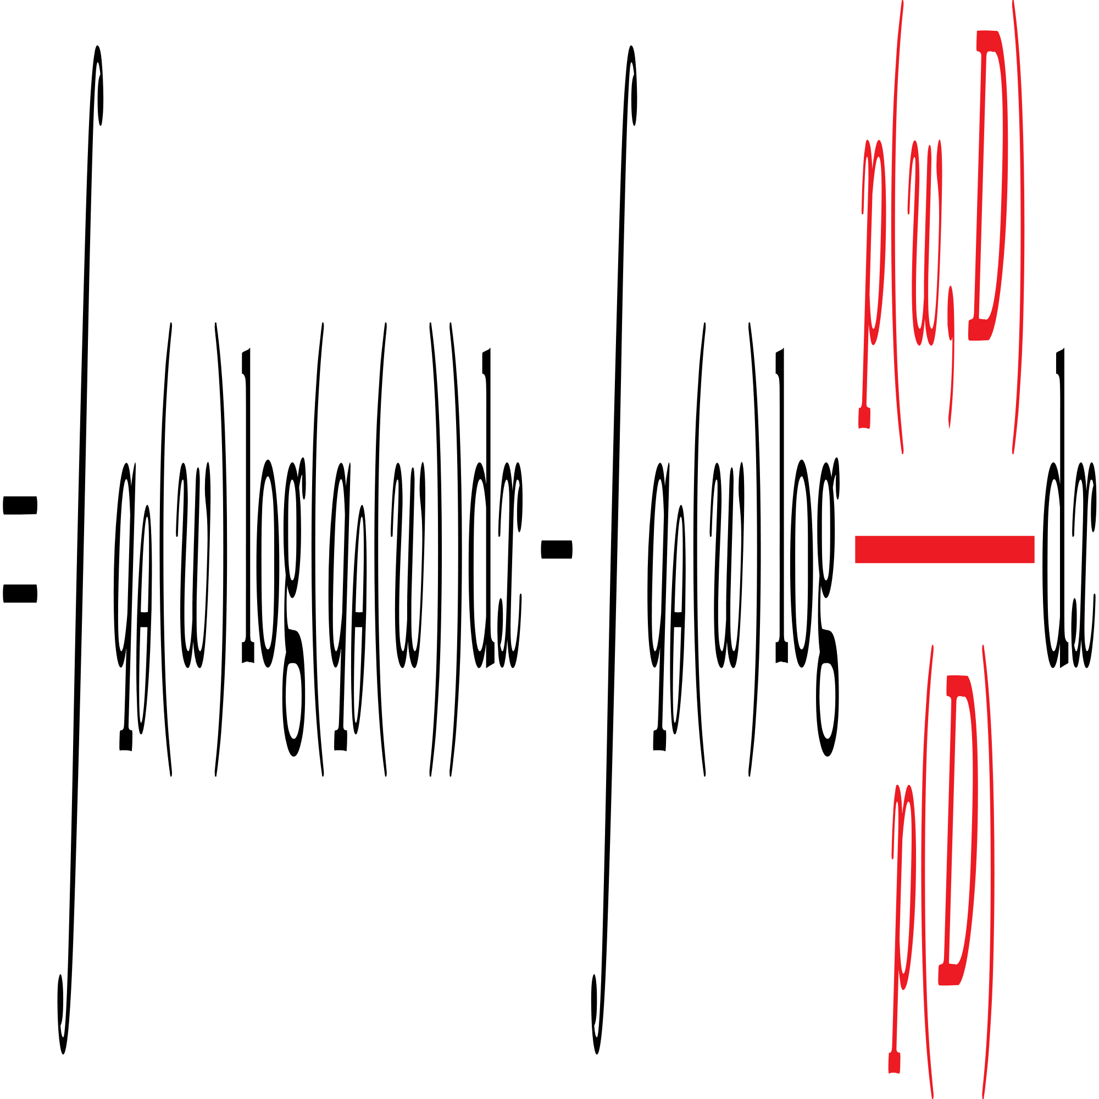
Variational Inference
Reference
[22] 「变分推断-1」贝叶斯统计 详细推导 Variational Inference「机器学习」

Slide 47
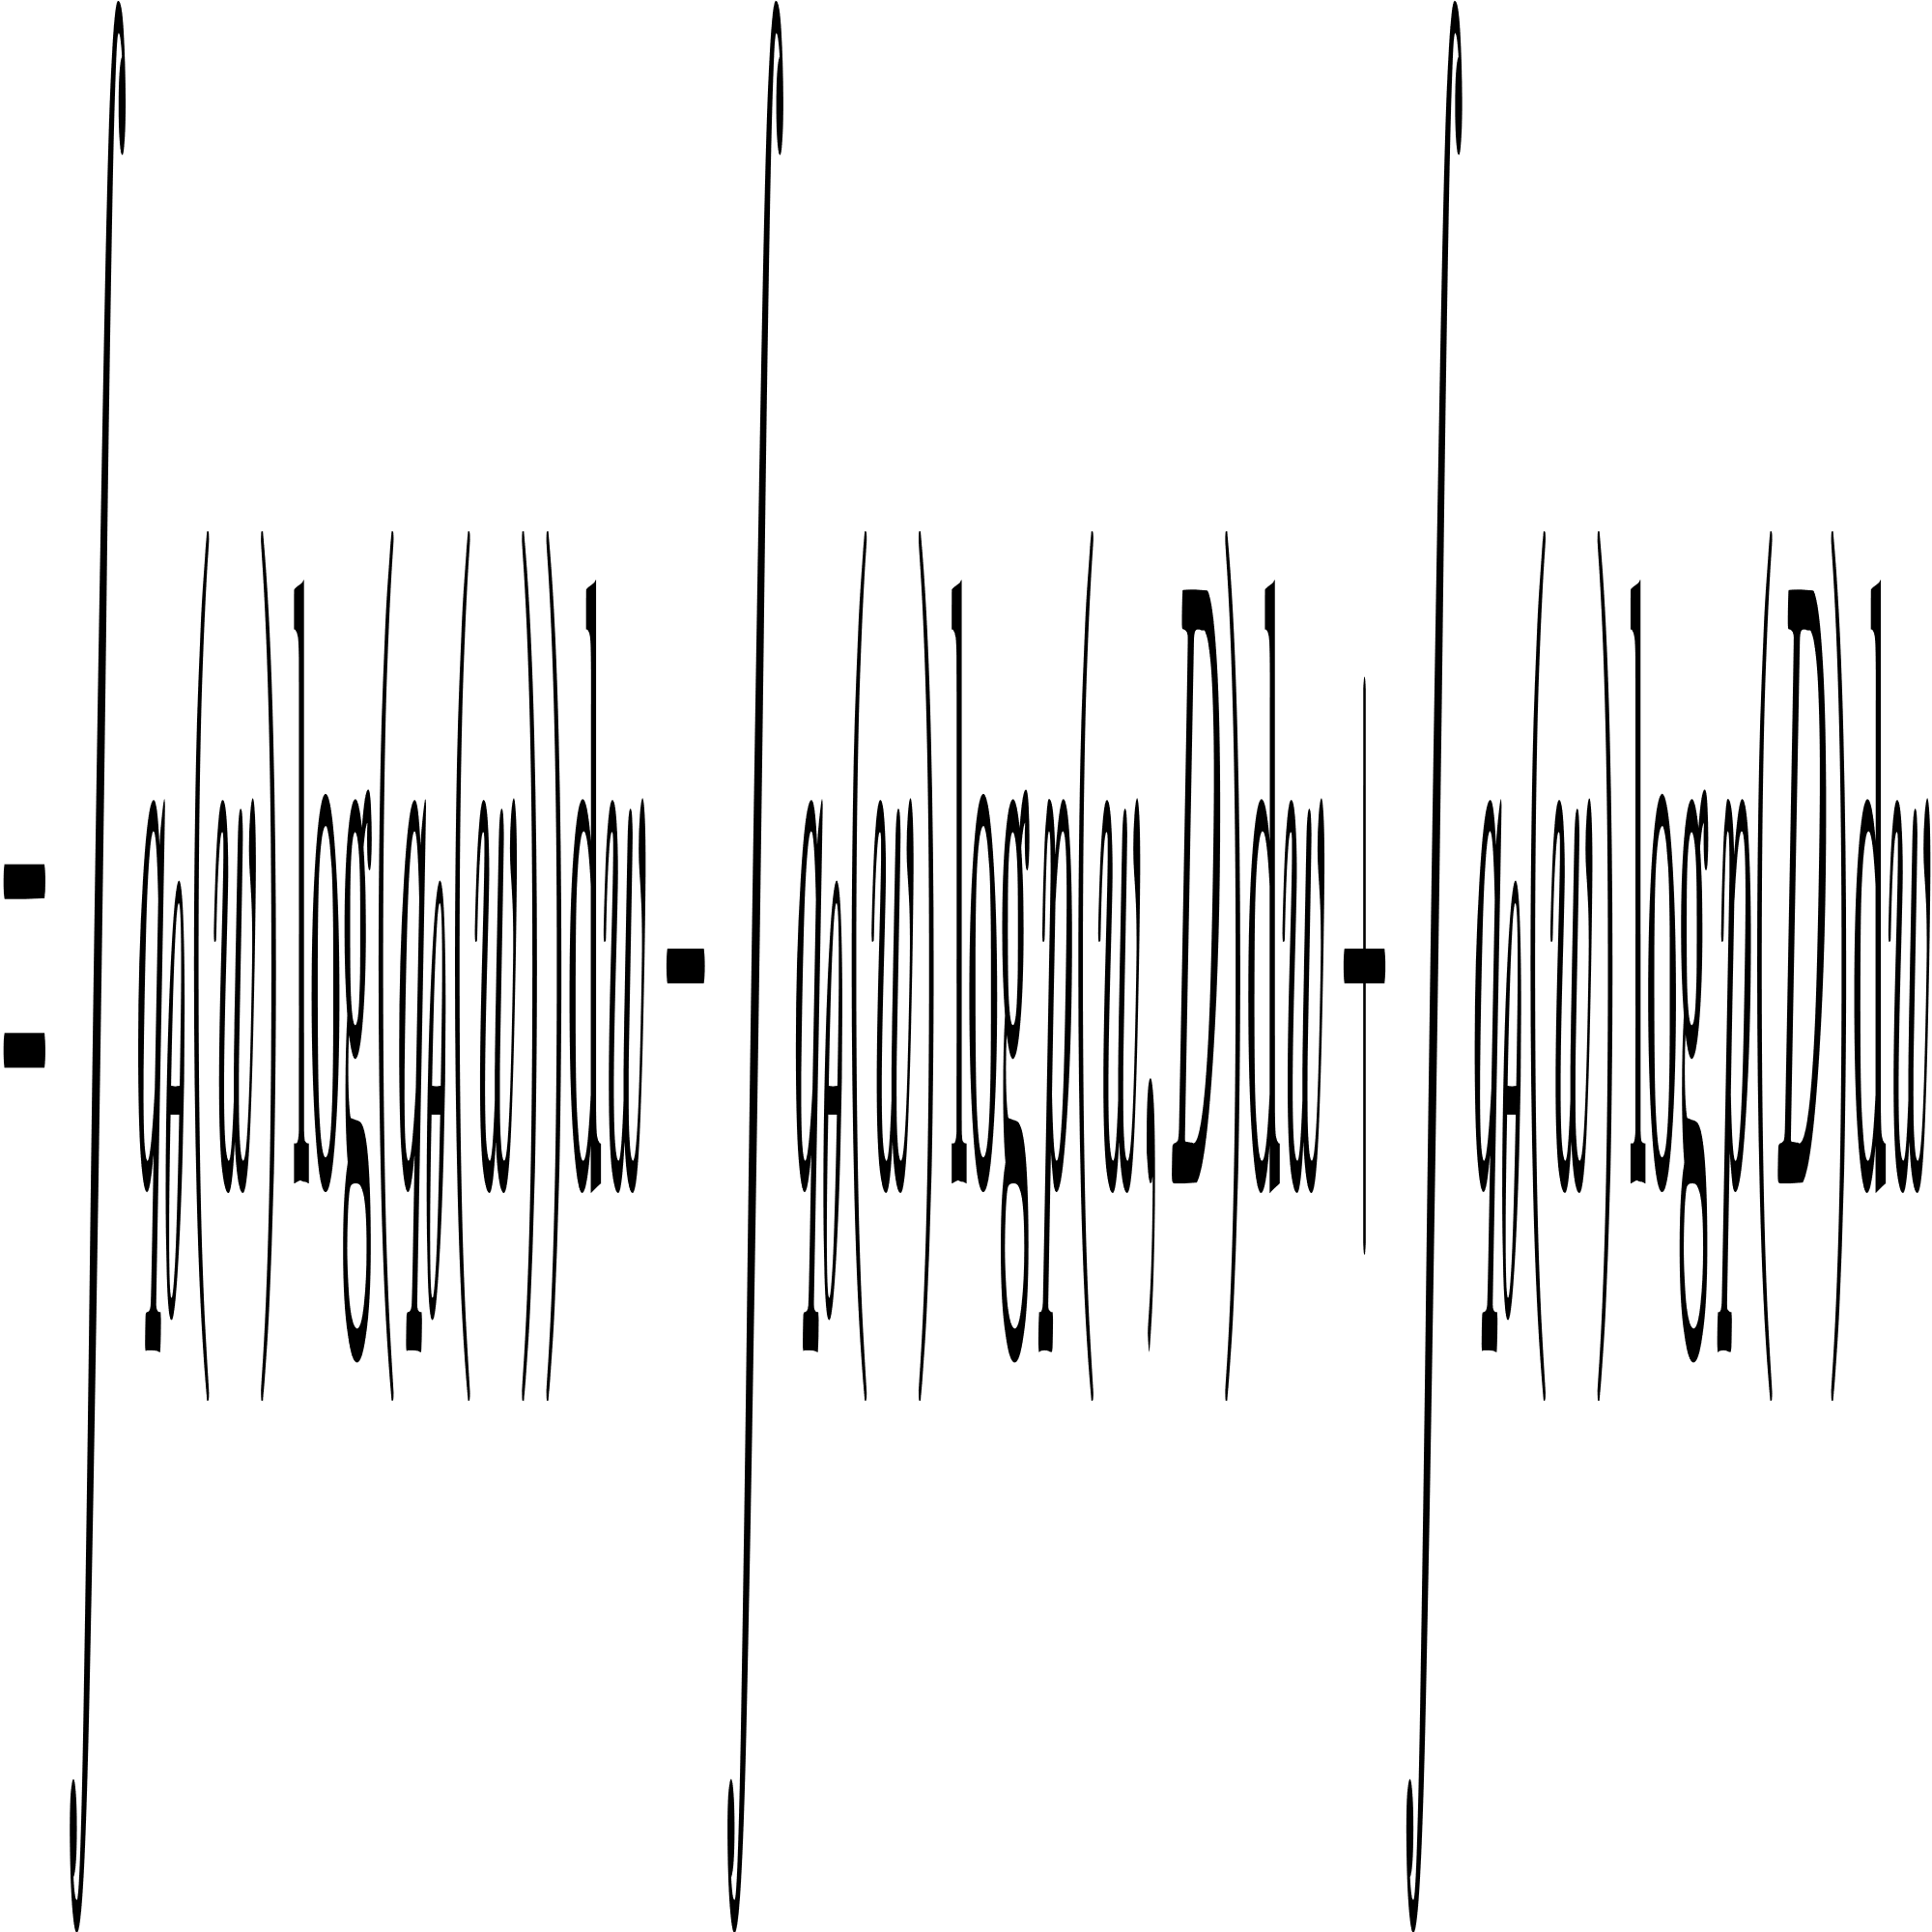
Variational Inference
Reference
[22] 「变分推断-1」贝叶斯统计 详细推导 Variational Inference「机器学习」

Slide 48
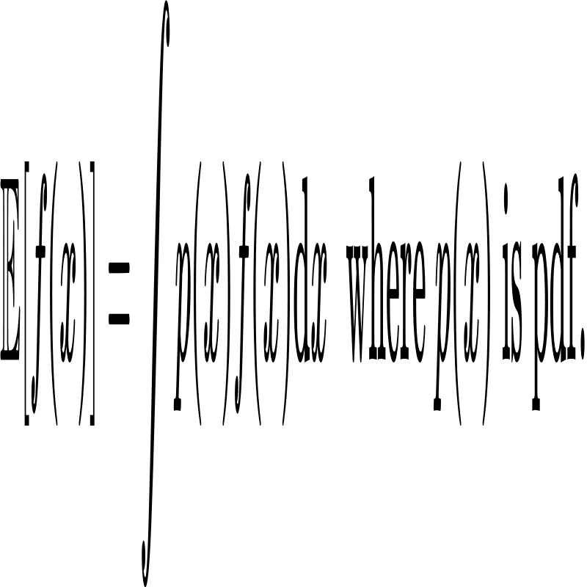
Variational Inference
Reference
[22] 「变分推断-1」贝叶斯统计 详细推导 Variational Inference「机器学习」

Slide 49
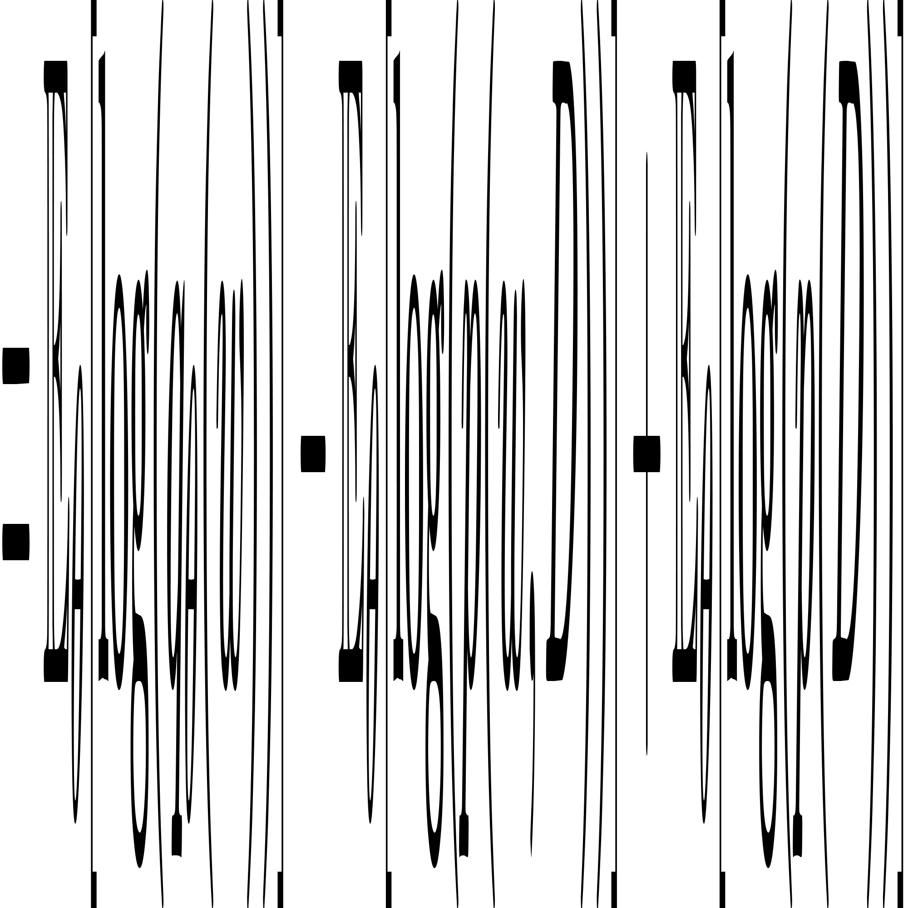
Variational Inference
Reference
[22] 「变分推断-1」贝叶斯统计 详细推导 Variational Inference「机器学习」

Slide 50
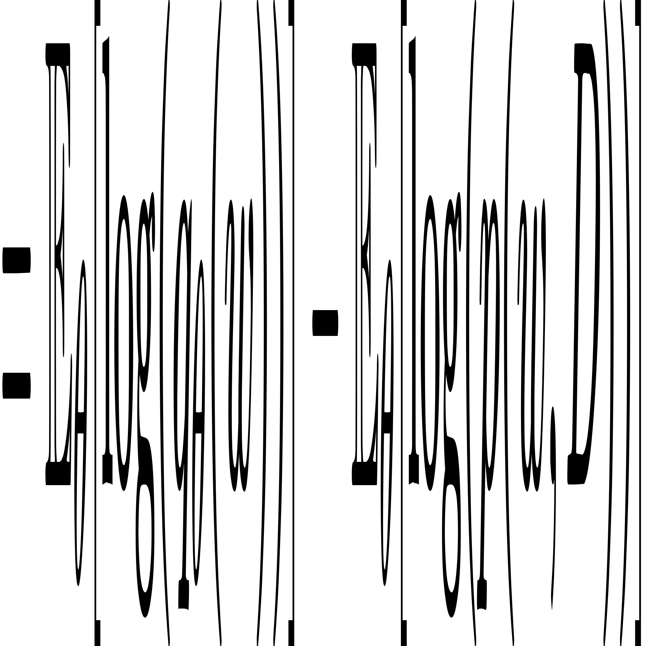
Variational Inference
Reference
[22] 「变分推断-1」贝叶斯统计 详细推导 Variational Inference「机器学习」

Slide 51
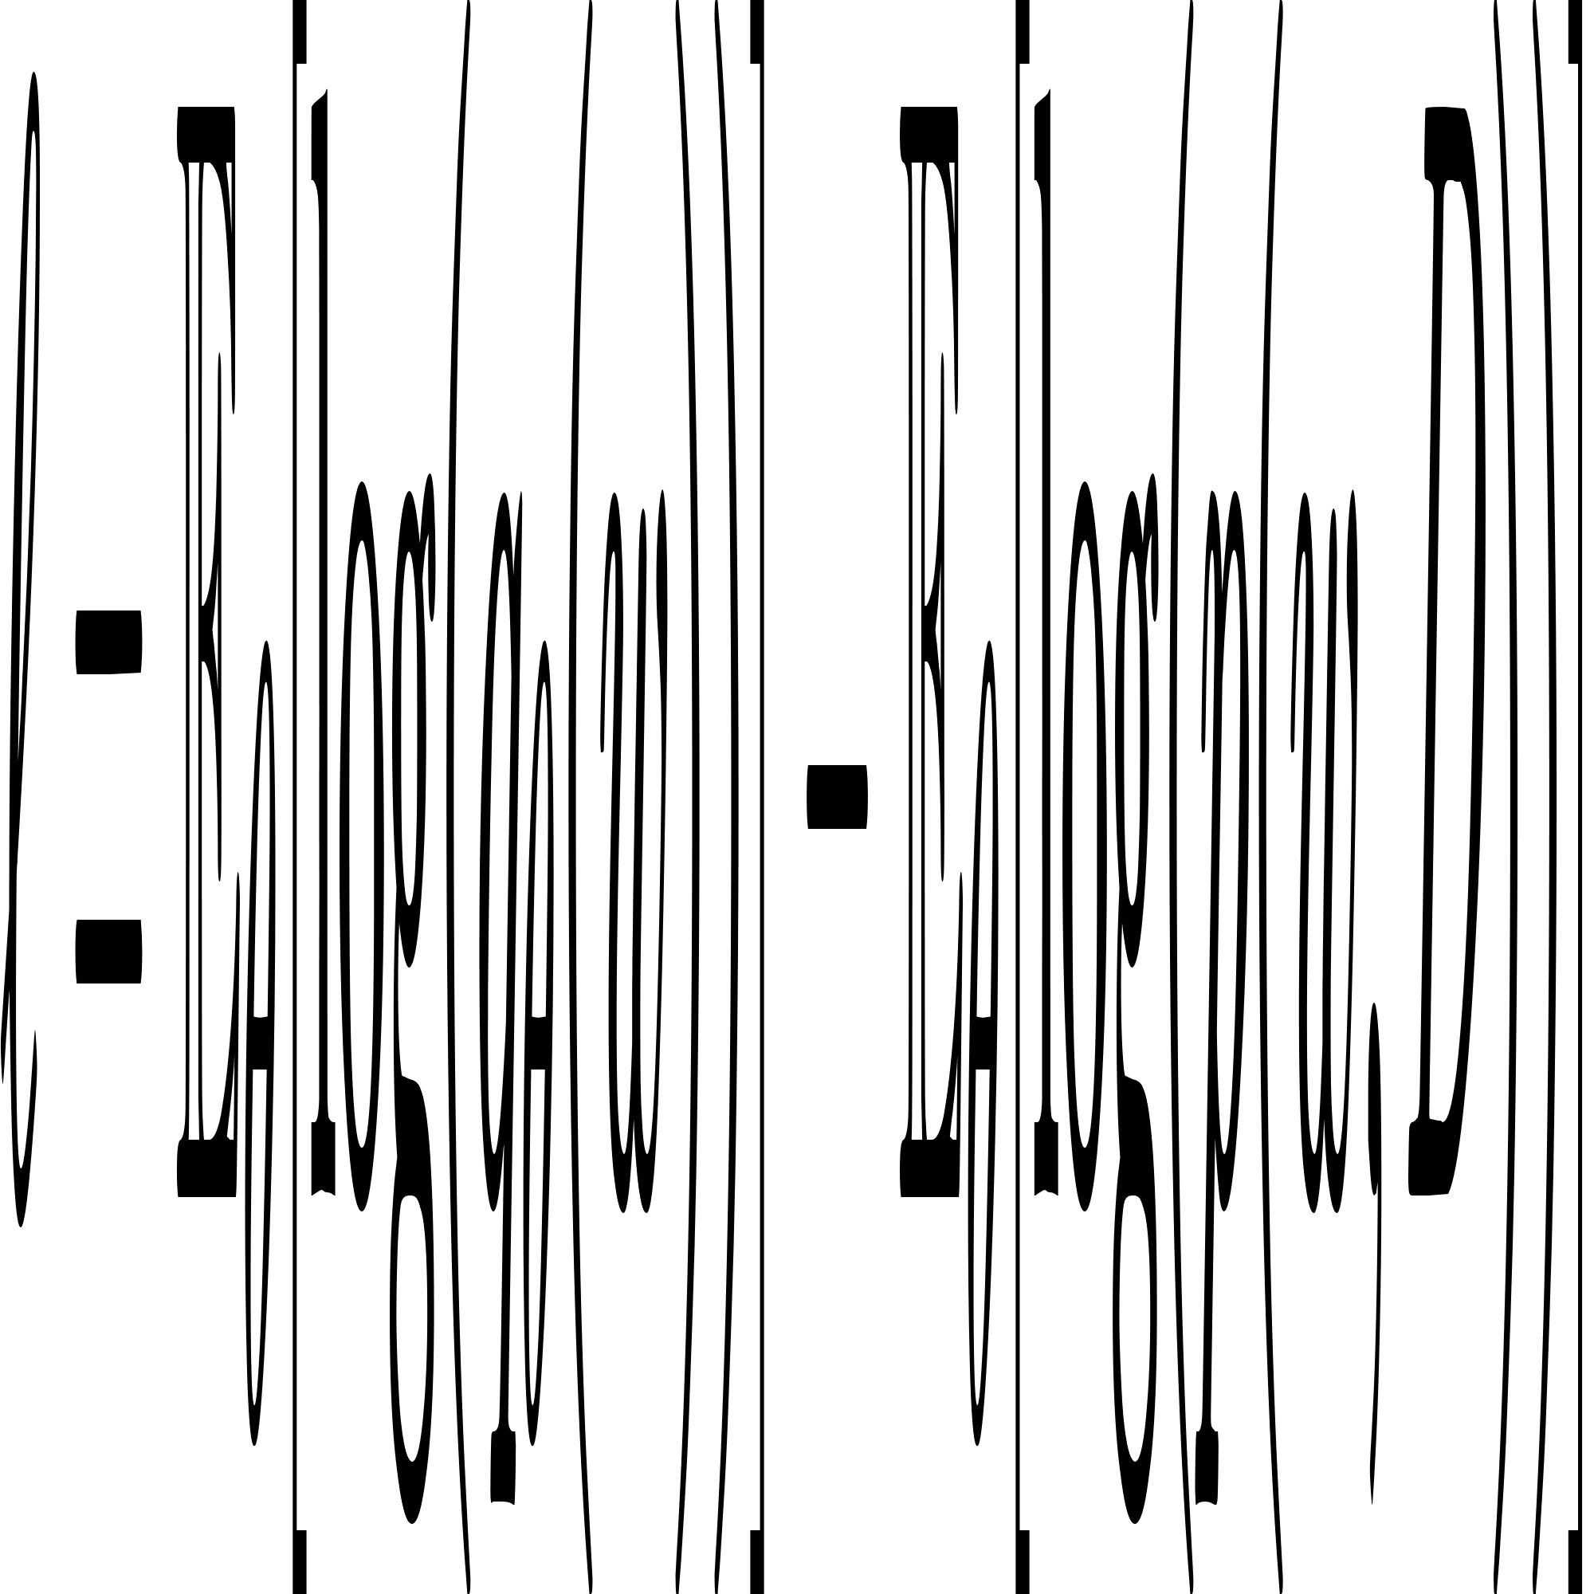
Variational Inference
Reference
[22] 「变分推断-1」贝叶斯统计 详细推导 Variational Inference「机器学习」

Slide 52
Uncertainty Quantification
Monte-Carlo Dropout

Slide 53
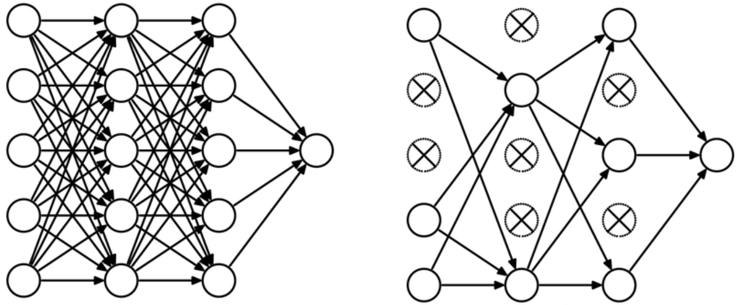
Monte-Carlo Dropout
Deep Learning models → Bayesian models
Dropout in NNs can be interpreted as a Bayesian approximation of a well known probabilistic model.
Reference
[12] Gal Y, Ghahramani Z. Dropout as a bayesian approximation: Representing model uncertainty in deep learning[C]//ICML, 2016: 1050-1059.

Slide 54
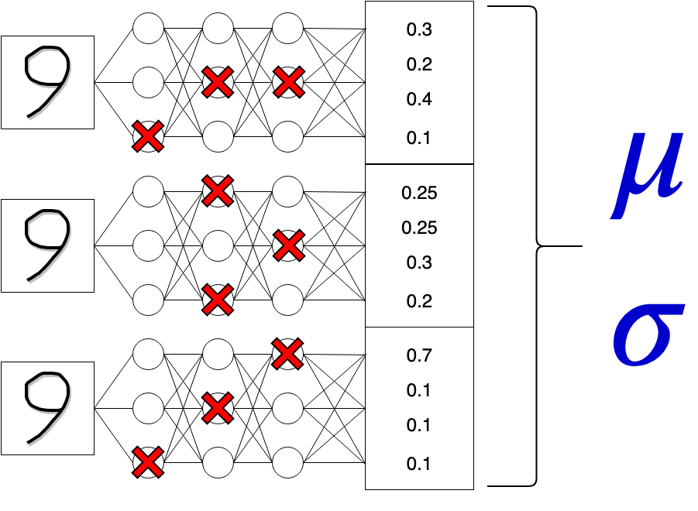
Monte-Carlo Dropout
Deep Learning models → Bayesian models
The training process is the same as for the deep learning model, and turn on Dropout during testing process.
The mean and variance are calculated from the multiple outputs to obtain the prediction results and uncertainty.
Reference
[12] Gal Y, Ghahramani Z. Dropout as a bayesian approximation: Representing model uncertainty in deep learning[C]//ICML, 2016: 1050-1059.

Slide 55
Monte-Carlo Dropout
Multiple forward propagation processes are performed for the same input for implement of “The weights are a distribution”.
Reference
[12] Gal Y, Ghahramani Z. Dropout as a bayesian approximation: Representing model uncertainty in deep learning[C]//ICML, 2016: 1050-1059.
[13] 什么是蒙特卡罗 Dropout(Monte-Carlo Dropout)？https://www.zhihu.com/question/352302787

Slide 56
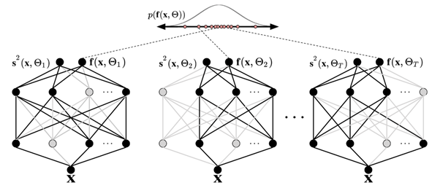
Monte-Carlo Dropout
Multiple forward propagation can be parallel
Reference
[14] Monte Carlo dropout https://docs.aws.amazon.com/prescriptive-guidance/latest/ml-quantifying-uncertainty/mc-dropout.html
[13] 什么是蒙特卡罗 Dropout(Monte-Carlo Dropout)？https://www.zhihu.com/question/352302787

Slide 57
Monte-Carlo Dropout
Bayesian probability theory usually has a high computational cost
MC Dropout directly converts deep learning models into Bayesian models without changing any model and optimization objectives.
Uncertainty quantification for deep learning models without sacrificing testing accuracy
Reference
[12] Gal Y, Ghahramani Z. Dropout as a bayesian approximation: Representing model uncertainty in deep learning[C]//ICML, 2016: 1050-1059.

Slide 58
Uncertainty Quantification
Bayesian Activate Learning

Slide 59
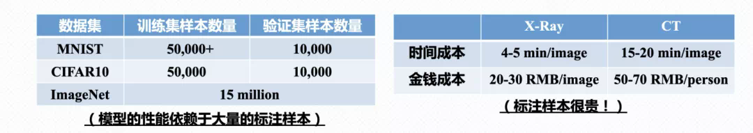
Bayesian Active Learning
Data annotation
Scarcity of special scene data
Labeling is expensive
Reference
[14] 主动学习入门篇：如何能够显著地减少标注代价 https://www.jiqizhixin.com/articles/2020-09-25-5

Slide 60
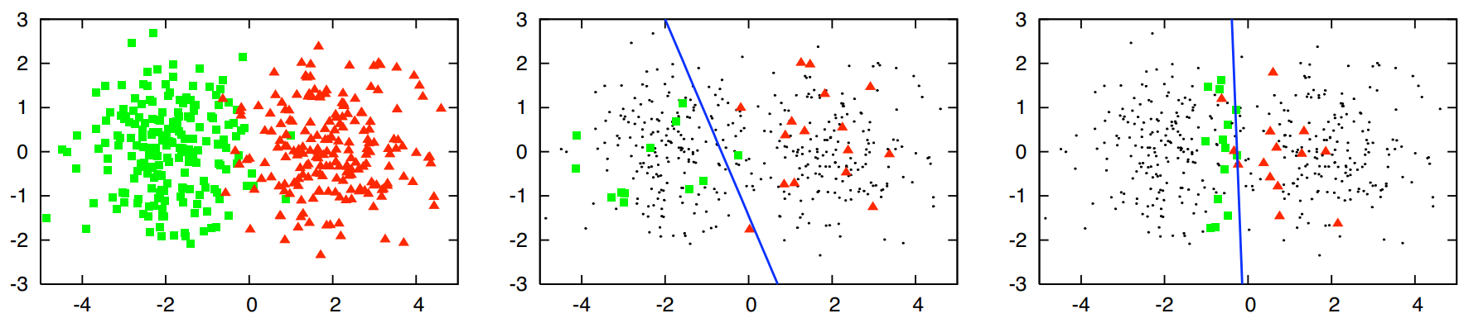
Bayesian Active Learning
Active Learning
Active learning trains better-performing models by selectively labeling less data.
All samples
Random labeling (30)
ACC = 0.7
AL labeling (30)
ACC = 0.9
Reference
[16] 主动学习（Active Learning），看这一篇就够了 https://zhuanlan.zhihu.com/p/377045943
[17] Settles B. Active learning literature survey[J]. 2009.

Slide 61
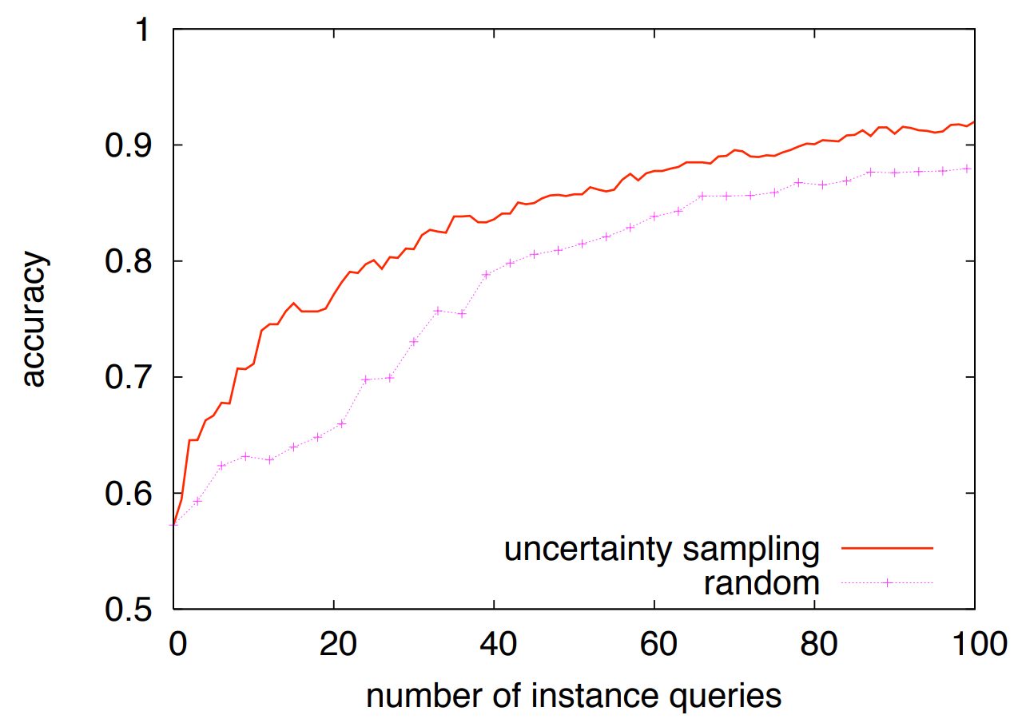
Bayesian Active Learning
Active Learning
The more data, the better the performance.
Active learning requires less data under the same performance.
Less data
Reference
[17] Settles B. Active learning literature survey[J]. 2009.

Slide 62
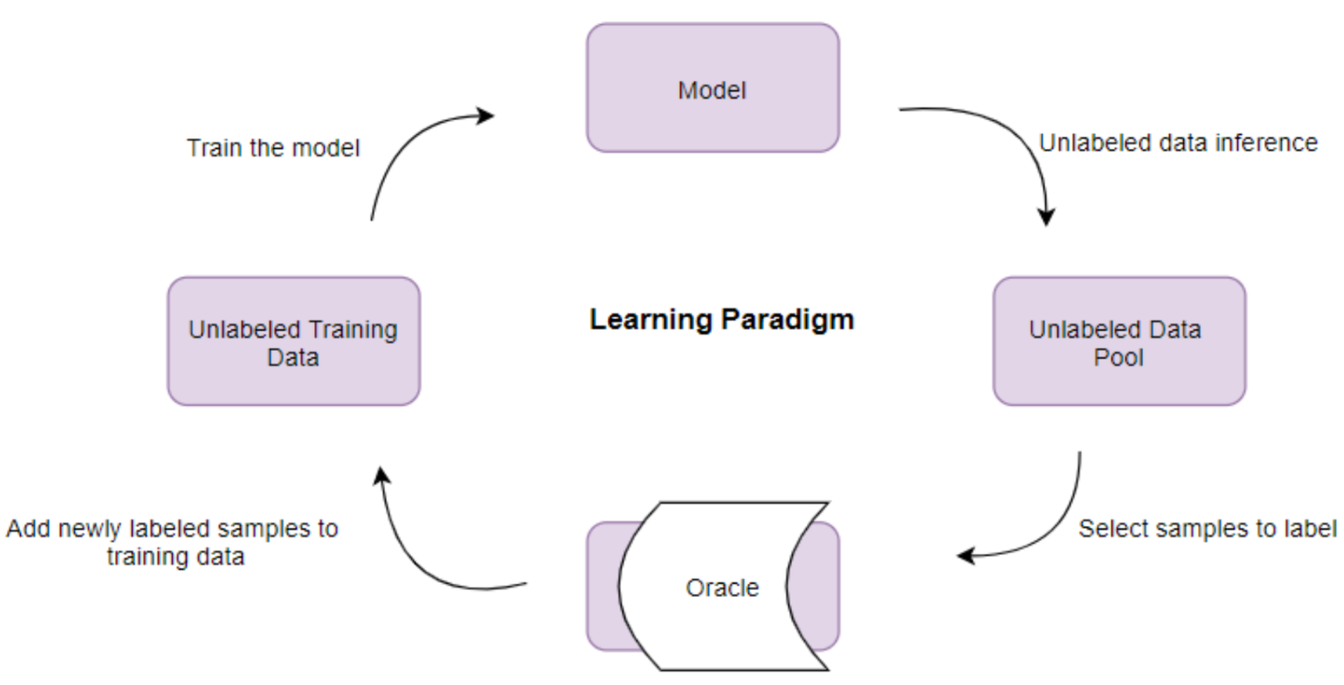

Bayesian Active Learning
Active Learning
Query function decides which samples are labeled.
Train on a new training set with labeled samples added from scratch.
Reference
[18] 【领域报告】主动学习年度进展|VALSE2018 https://zhuanlan.zhihu.com/p/38029108
[20] Mohamadi S, Amindavar H. Deep bayesian active learning, a brief survey on recent advances[J]. arXiv preprint arXiv:2012.08044, 2020.

Slide 63

Bayesian Active Learning
Query function
Select high uncertainty data for labeling to improve the recognition ability.
Reference
[19] Gal Y, Islam R, Ghahramani Z. Deep bayesian active learning with image data[C] ICML, 2017: 1183-1192.
[18] 【领域报告】主动学习年度进展|VALSE2018 https://zhuanlan.zhihu.com/p/38029108

Slide 64
Uncertainty Quantification in FSL

Slide 65

Problem Formulation
Examples of classification scores and uncertainty.
The smaller the uncertainty, the higher the confidence of the classification result.
Reference
[23] Yuan M, Xu Q, Cai C, et al. Uncertainty-Based Network for Few-Shot Image Classification[C] //2022 IEEE ICME. IEEE, 2022: 1-6.

Slide 66





Problem Formulation
Prototype
to class-
denotes the support set of the -th class
denotes the number of samples in

Slide 67




Problem Formulation
Probability of classifying it into the class-
is the number of classes
denotes the similarity metric
is a hyper-parameter

Slide 68

Bayesian for UQ
Model the similarity between a query feature and a prototype feature by a distribution
Based on graph-based similarity uncertainty estimation.
Reference
[15] Zhang Z, Lan C, Zeng W, et al. Uncertainty-aware few-shot image classification[J]. arXiv preprint arXiv:2010.04525, 2020.

Slide 69
Bayesian for UQ
Convert the feature similarity from a deterministic scalar to a distribution
（probabilistic representation）
Reference
[15] Zhang Z, Lan C, Zeng W, et al. Uncertainty-aware few-shot image classification[J]. arXiv preprint arXiv:2010.04525, 2020.

Slide 70

Bayesian for UQ
Probabilistic Similarity Representation
Model the Gaussian distribution of the similarity between this query and the prototype with mean and variance.
Reference
[15] Zhang Z, Lan C, Zeng W, et al. Uncertainty-aware few-shot image classification[J]. arXiv preprint arXiv:2010.04525, 2020.

Slide 71



Bayesian for UQ
Probabilistic Similarity Representation
Model the Gaussian distribution of the similarity between this query and the prototype with mean and variance.
Mean
This denotes the most likely value of the similarity between and
Reference
[15] Zhang Z, Lan C, Zeng W, et al. Uncertainty-aware few-shot image classification[J]. arXiv preprint arXiv:2010.04525, 2020.

Slide 72

Bayesian for UQ
Similarity Uncertainty Estimation
Estimate the uncertainty by variance
Reference
[15] Zhang Z, Lan C, Zeng W, et al. Uncertainty-aware few-shot image classification[J]. arXiv preprint arXiv:2010.04525, 2020.

Slide 73



Bayesian for UQ
Similarity Uncertainty Estimation
A query sample
The prototypes of the support set as
Reference
[15] Zhang Z, Lan C, Zeng W, et al. Uncertainty-aware few-shot image classification[J]. arXiv preprint arXiv:2010.04525, 2020.

Slide 74



Bayesian for UQ
Similarity Uncertainty Estimation
A query sample
The prototypes of the support set as
Split and into groups along their channel dimensions.
Reference
[15] Zhang Z, Lan C, Zeng W, et al. Uncertainty-aware few-shot image classification[J]. arXiv preprint arXiv:2010.04525, 2020.

Slide 75



Bayesian for UQ
Similarity Uncertainty Estimation
Cosine similarity
Multiple groups provide the similarity from different perspectives.
Reference
[15] Zhang Z, Lan C, Zeng W, et al. Uncertainty-aware few-shot image classification[J]. arXiv preprint arXiv:2010.04525, 2020.

Slide 76


Bayesian for UQ
Similarity Uncertainty Estimation
The nodes in the graph are represented by a matrix
Reference
[15] Zhang Z, Lan C, Zeng W, et al. Uncertainty-aware few-shot image classification[J]. arXiv preprint arXiv:2010.04525, 2020.

Slide 77
Bayesian for UQ
Similarity Uncertainty Estimation
Model edge
Reference
[15] Zhang Z, Lan C, Zeng W, et al. Uncertainty-aware few-shot image classification[J]. arXiv preprint arXiv:2010.04525, 2020.

Slide 78

Bayesian for UQ
Similarity Uncertainty Estimation
Model the edge of any two nodes
Reference
[15] Zhang Z, Lan C, Zeng W, et al. Uncertainty-aware few-shot image classification[J]. arXiv preprint arXiv:2010.04525, 2020.

Slide 79

Bayesian for UQ
Similarity Uncertainty Estimation
Model the edge of any two nodes
Reference
[15] Zhang Z, Lan C, Zeng W, et al. Uncertainty-aware few-shot image classification[J]. arXiv preprint arXiv:2010.04525, 2020.

Slide 80

Bayesian for UQ
Similarity Uncertainty Estimation
Graph structure
Reference
[15] Zhang Z, Lan C, Zeng W, et al. Uncertainty-aware few-shot image classification[J]. arXiv preprint arXiv:2010.04525, 2020.

Slide 81






Bayesian for UQ
Similarity Uncertainty Estimation
Update by normalized adjacent matrix and learnable transformation matrices
$1×1$ Convolution
2 Stacked blocks
Reference
[15] Zhang Z, Lan C, Zeng W, et al. Uncertainty-aware few-shot image classification[J]. arXiv preprint arXiv:2010.04525, 2020.

Slide 82



Bayesian for UQ
Similarity Uncertainty Estimation
LeakyReLU
Learnable transformation matrices
Reference
[15] Zhang Z, Lan C, Zeng W, et al. Uncertainty-aware few-shot image classification[J]. arXiv preprint arXiv:2010.04525, 2020.

Slide 83




Bayesian for UQ
Uncertainty-aware Optimization
Sampling re-parameterizing on each query-prototype pair
Repeat random sampling
Reference
[15] Zhang Z, Lan C, Zeng W, et al. Uncertainty-aware few-shot image classification[J]. arXiv preprint arXiv:2010.04525, 2020.

Slide 84

Shannon entropy for UQ
Data augmentation in the support set and query set.
Uncertainty quantification using Shannon entropy.
Uncertainty is used to aid in classification and update the prototype.
Reference
[23] Yuan M, Xu Q, Cai C, et al. Uncertainty-Based Network for Few-Shot Image Classification[C] //2022 IEEE ICME. IEEE, 2022: 1-6.

Slide 85




Shannon entropy for UQ
Data augmentation in the support set and query set.
denote the data augmentation algorithms
$(m+1)$ different data augmentation algorithms
$$n$$
$$n(m+1)$$
Reference
[23] Yuan M, Xu Q, Cai C, et al. Uncertainty-Based Network for Few-Shot Image Classification[C] //2022 IEEE ICME. IEEE, 2022: 1-6.

Slide 86



Shannon entropy for UQ
Feature extraction in support set
The augmented image is sent to for feature extraction
Prototypes are computed by averaging the feature map of these augmented support instances.
Reference
[23] Yuan M, Xu Q, Cai C, et al. Uncertainty-Based Network for Few-Shot Image Classification[C] //2022 IEEE ICME. IEEE, 2022: 1-6.

Slide 87


Shannon entropy for UQ
Feature extraction in support set
The augmented image is sent to for feature extraction.
Each augmented image corresponds to a feature vector
Reference
[23] Yuan M, Xu Q, Cai C, et al. Uncertainty-Based Network for Few-Shot Image Classification[C] //2022 IEEE ICME. IEEE, 2022: 1-6.

Slide 88



Shannon entropy for UQ
Matchnig based on matric module
Prototypes
Query set
Classifcation scores
Reference
[23] Yuan M, Xu Q, Cai C, et al. Uncertainty-Based Network for Few-Shot Image Classification[C] //2022 IEEE ICME. IEEE, 2022: 1-6.

Slide 89
Shannon entropy for UQ
Matchnig based on matric module
Query set
Classifcation scores
Reference
[23] Yuan M, Xu Q, Cai C, et al. Uncertainty-Based Network for Few-Shot Image Classification[C] //2022 IEEE ICME. IEEE, 2022: 1-6.

Slide 90




Shannon entropy for UQ
Matchnig based on matric module
Each augmented image corresponds to the classification score of each prototype category.
indicates the Euclidean distance metric with a learnable parameter
Reference
[23] Yuan M, Xu Q, Cai C, et al. Uncertainty-Based Network for Few-Shot Image Classification[C] //2022 IEEE ICME. IEEE, 2022: 1-6.

Slide 91




Shannon entropy for UQ
Refining the prototypes in iteration $t$
Reference
[23] Yuan M, Xu Q, Cai C, et al. Uncertainty-Based Network for Few-Shot Image Classification[C] //2022 IEEE ICME. IEEE, 2022: 1-6.

Slide 92

Shannon entropy for UQ
Unceertainty qulification
Direct averaging and weight allocation yield two separate classification scores
Weight allocation by uncertainty qulification.
Reference
[23] Yuan M, Xu Q, Cai C, et al. Uncertainty-Based Network for Few-Shot Image Classification[C] //2022 IEEE ICME. IEEE, 2022: 1-6.

Slide 93

Shannon entropy for UQ
Average classification scores
Reference
[23] Yuan M, Xu Q, Cai C, et al. Uncertainty-Based Network for Few-Shot Image Classification[C] //2022 IEEE ICME. IEEE, 2022: 1-6.

Slide 94


Shannon entropy for UQ
Weight allocation
Shannon entropy for uncertainty qulificaton
Shannon entropy
Reference
[23] Yuan M, Xu Q, Cai C, et al. Uncertainty-Based Network for Few-Shot Image Classification[C] //2022 IEEE ICME. IEEE, 2022: 1-6.

Slide 95




Shannon entropy for UQ
Weight allocation
Infer weights for query Instances.
is a multi-head attention module
Reference
[23] Yuan M, Xu Q, Cai C, et al. Uncertainty-Based Network for Few-Shot Image Classification[C] //2022 IEEE ICME. IEEE, 2022: 1-6.

Slide 96


Shannon entropy for UQ
Updated prototypes
Iterate $t$ times to get the refined prototype.
Reference
[23] Yuan M, Xu Q, Cai C, et al. Uncertainty-Based Network for Few-Shot Image Classification[C] //2022 IEEE ICME. IEEE, 2022: 1-6.

Slide 97

Shannon entropy for UQ
Matching
Using refined prototype.
Reference
[23] Yuan M, Xu Q, Cai C, et al. Uncertainty-Based Network for Few-Shot Image Classification[C] //2022 IEEE ICME. IEEE, 2022: 1-6.

Slide 98
Dateset

Slide 99

mini-ImageNet
mini-ImageNet
is a subset from ImageNet
60000 images & 100 class
84×84 pixels
Train | Test
50000 | 10000
https://lyy.mpi-inf.mpg.de/mtl/download/Lmzjm9tX.html
Reference
[24] Vinyals O, Blundell C, Lillicrap T, et al. Matching networks for one shot learning[J]. Advances in neural information processing systems, 2016, 29.

Slide 100

tiered-ImageNet
tiered-ImageNet
is a subset from ImageNet
779154 images & 608 class
84×84 pixels
Train | Val | Test
448695 | 124261 | 206209
https://github.com/yaoyao-liu/tiered-imagenet-tools
Reference
[25] Ren M, Triantafillou E, Ravi S, et al. Meta-learning for semi-supervised few-shot classification[J]. arXiv preprint arXiv:1803.00676, 2018.
[26] 小样本数据集：tieredImageNet数据集小样本数据集：tieredImageNet数据集 https://zhuanlan.zhihu.com/p/436836671

Slide 101

CIFAR-FS
CIFAR100 few-shots
CIFAR-FS is randomly sampled from CIFAR-100
60000 images & 100 classes
32×32 pixels
Train | Val | Test
64 | 16 | 20
https://github.com/bertinetto/r2d2
Reference
[27] Bertinetto L, Henriques J F, Torr P H S, et al. Meta-learning with differentiable closed-form solvers[J]. arXiv preprint arXiv:1805.08136, 2018.

Slide 102

FC100
FC100
CIFAR-FS is a subset from CIFAR-100
60000 images & 20 super classes & 60 classes
32×32 pixels
Train | Val | Test
12 (20) | 4 (20) | 4 (20)
https://lyy.mpi-inf.mpg.de/mtl/download/Lmzjm9tX.html
Reference
[28] Oreshkin B, Rodríguez López P, Lacoste A. Tadam: Task dependent adaptive metric for improved few-shot learning[J]. NIPS, 2018, 31.
[29] 小样本数据集：CIFAR-FS和FC100数据集 https://zhuanlan.zhihu.com/p/436840445

Slide 103
Reference
Lu J, Gong P, Ye J, et al. Learning from very few samples: A survey[J]. arXiv preprint arXiv:2009.02653, 2020.
NHTSA. PE 16-007. Technical report, U.S. Department of Transportation, National Highway Traffic Safety Administration, Jan 2017. Tesla Crash Preliminary
Wang Y, Yao Q, Kwok J T, et al. Generalizing from a few examples: A survey on few-shot learning[J]. ACM computing surveys (csur), 2020, 53(3): 1-34. Evaluation Report.
Abdar M, Pourpanah F, Hussain S, et al. A review of uncertainty quantification in deep learning: Techniques, applications and challenges[J]. Information Fusion, 2021, 76: 243-297.
朱军——贝叶斯深度学习（线上讲座）清华大学 2022.9. https://www.bilibili.com/video/BV1be411g7u7/?spm_id_from=333.337.search-card.all.click
深度学习中的两种不确定性 https://zhuanlan.zhihu.com/p/56986840
贝叶斯神经网络及其在自动驾驶中的应用 https://www.bilibili.com/video/BV1DB4y1k7vN/?spm_id_from=333.337.search-card.all.click
What My Deep Model Doesn't Know... http://www.cs.ox.ac.uk/people/yarin.gal/website/blog_3d801aa532c1ce.html
Blundell C, Cornebise J, Kavukcuoglu K, et al. Weight uncertainty in neural network[C] ICLR, 2015: 1613-1622.
Goan E, Fookes C. Bayesian neural networks: An introduction and survey[J]. Case Studies in Applied Bayesian Data Science: CIRM Jean-Morlet Chair, Fall 2018, 2020: 45-87.
Jospin L V, Laga H, Boussaid F, et al. Hands-on Bayesian neural networks—A tutorial for deep learning users[J]. IEEE Computational Intelligence Magazine, 2022, 17(2): 29-48.
Gal Y, Ghahramani Z. Dropout as a bayesian approximation: Representing model uncertainty in deep learning[C] ICML, 2016: 1050-1059.
什么是蒙特卡罗 Dropout(Monte-Carlo Dropout)？https://www.zhihu.com/question/352302787
主动学习入门篇：如何能够显著地减少标注代价 https://www.jiqizhixin.com/articles/2020-09-25-5
Zhang Z, Lan C, Zeng W, et al. Uncertainty-aware few-shot image classification[J]. arXiv preprint arXiv:2010.04525, 2020.
主动学习（Active Learning），看这一篇就够了 https://zhuanlan.zhihu.com/p/377045943
Settles B. Active learning literature survey[J]. 2009.
【领域报告】主动学习年度进展|VALSE2018 https://zhuanlan.zhihu.com/p/38029108
Gal Y, Islam R, Ghahramani Z. Deep bayesian active learning with image data[C] ICML, 2017: 1183-1192.
Mohamadi S, Amindavar H. Deep bayesian active learning, a brief survey on recent advances[J]. arXiv preprint arXiv:2012.08044, 2020.
KL散度超详细讲解. https://blog.csdn.net/weixin_37763870/article/details/103026505
「变分推断-1」贝叶斯统计 详细推导 Variational Inference「机器学习」

Slide 104
Reference
Yuan M, Xu Q, Cai C, et al. Uncertainty-Based Network for Few-Shot Image Classification[C] //2022 IEEE International Conference on Multimedia and Expo (ICME). IEEE, 2022: 1-6.
Vinyals O, Blundell C, Lillicrap T, et al. Matching networks for one shot learning[J]. Advances in neural information processing systems, 2016, 29.
Ren M, Triantafillou E, Ravi S, et al. Meta-learning for semi-supervised few-shot classification[J]. arXiv preprint arXiv:1803.00676, 2018.
小样本数据集：tieredImageNet数据集小样本数据集：tieredImageNet数据集 https://zhuanlan.zhihu.com/p/436836671
Bertinetto L, Henriques J F, Torr P H S, et al. Meta-learning with differentiable closed-form solvers[J]. arXiv preprint arXiv:1805.08136, 2018.
reshkin B, Rodríguez López P, Lacoste A. Tadam: Task dependent adaptive metric for improved few-shot learning[J]. NIPS, 2018, 31.
小样本数据集：CIFAR-FS和FC100数据集 https://zhuanlan.zhihu.com/p/436840445

Slide 105
Thanks

